Slide 1
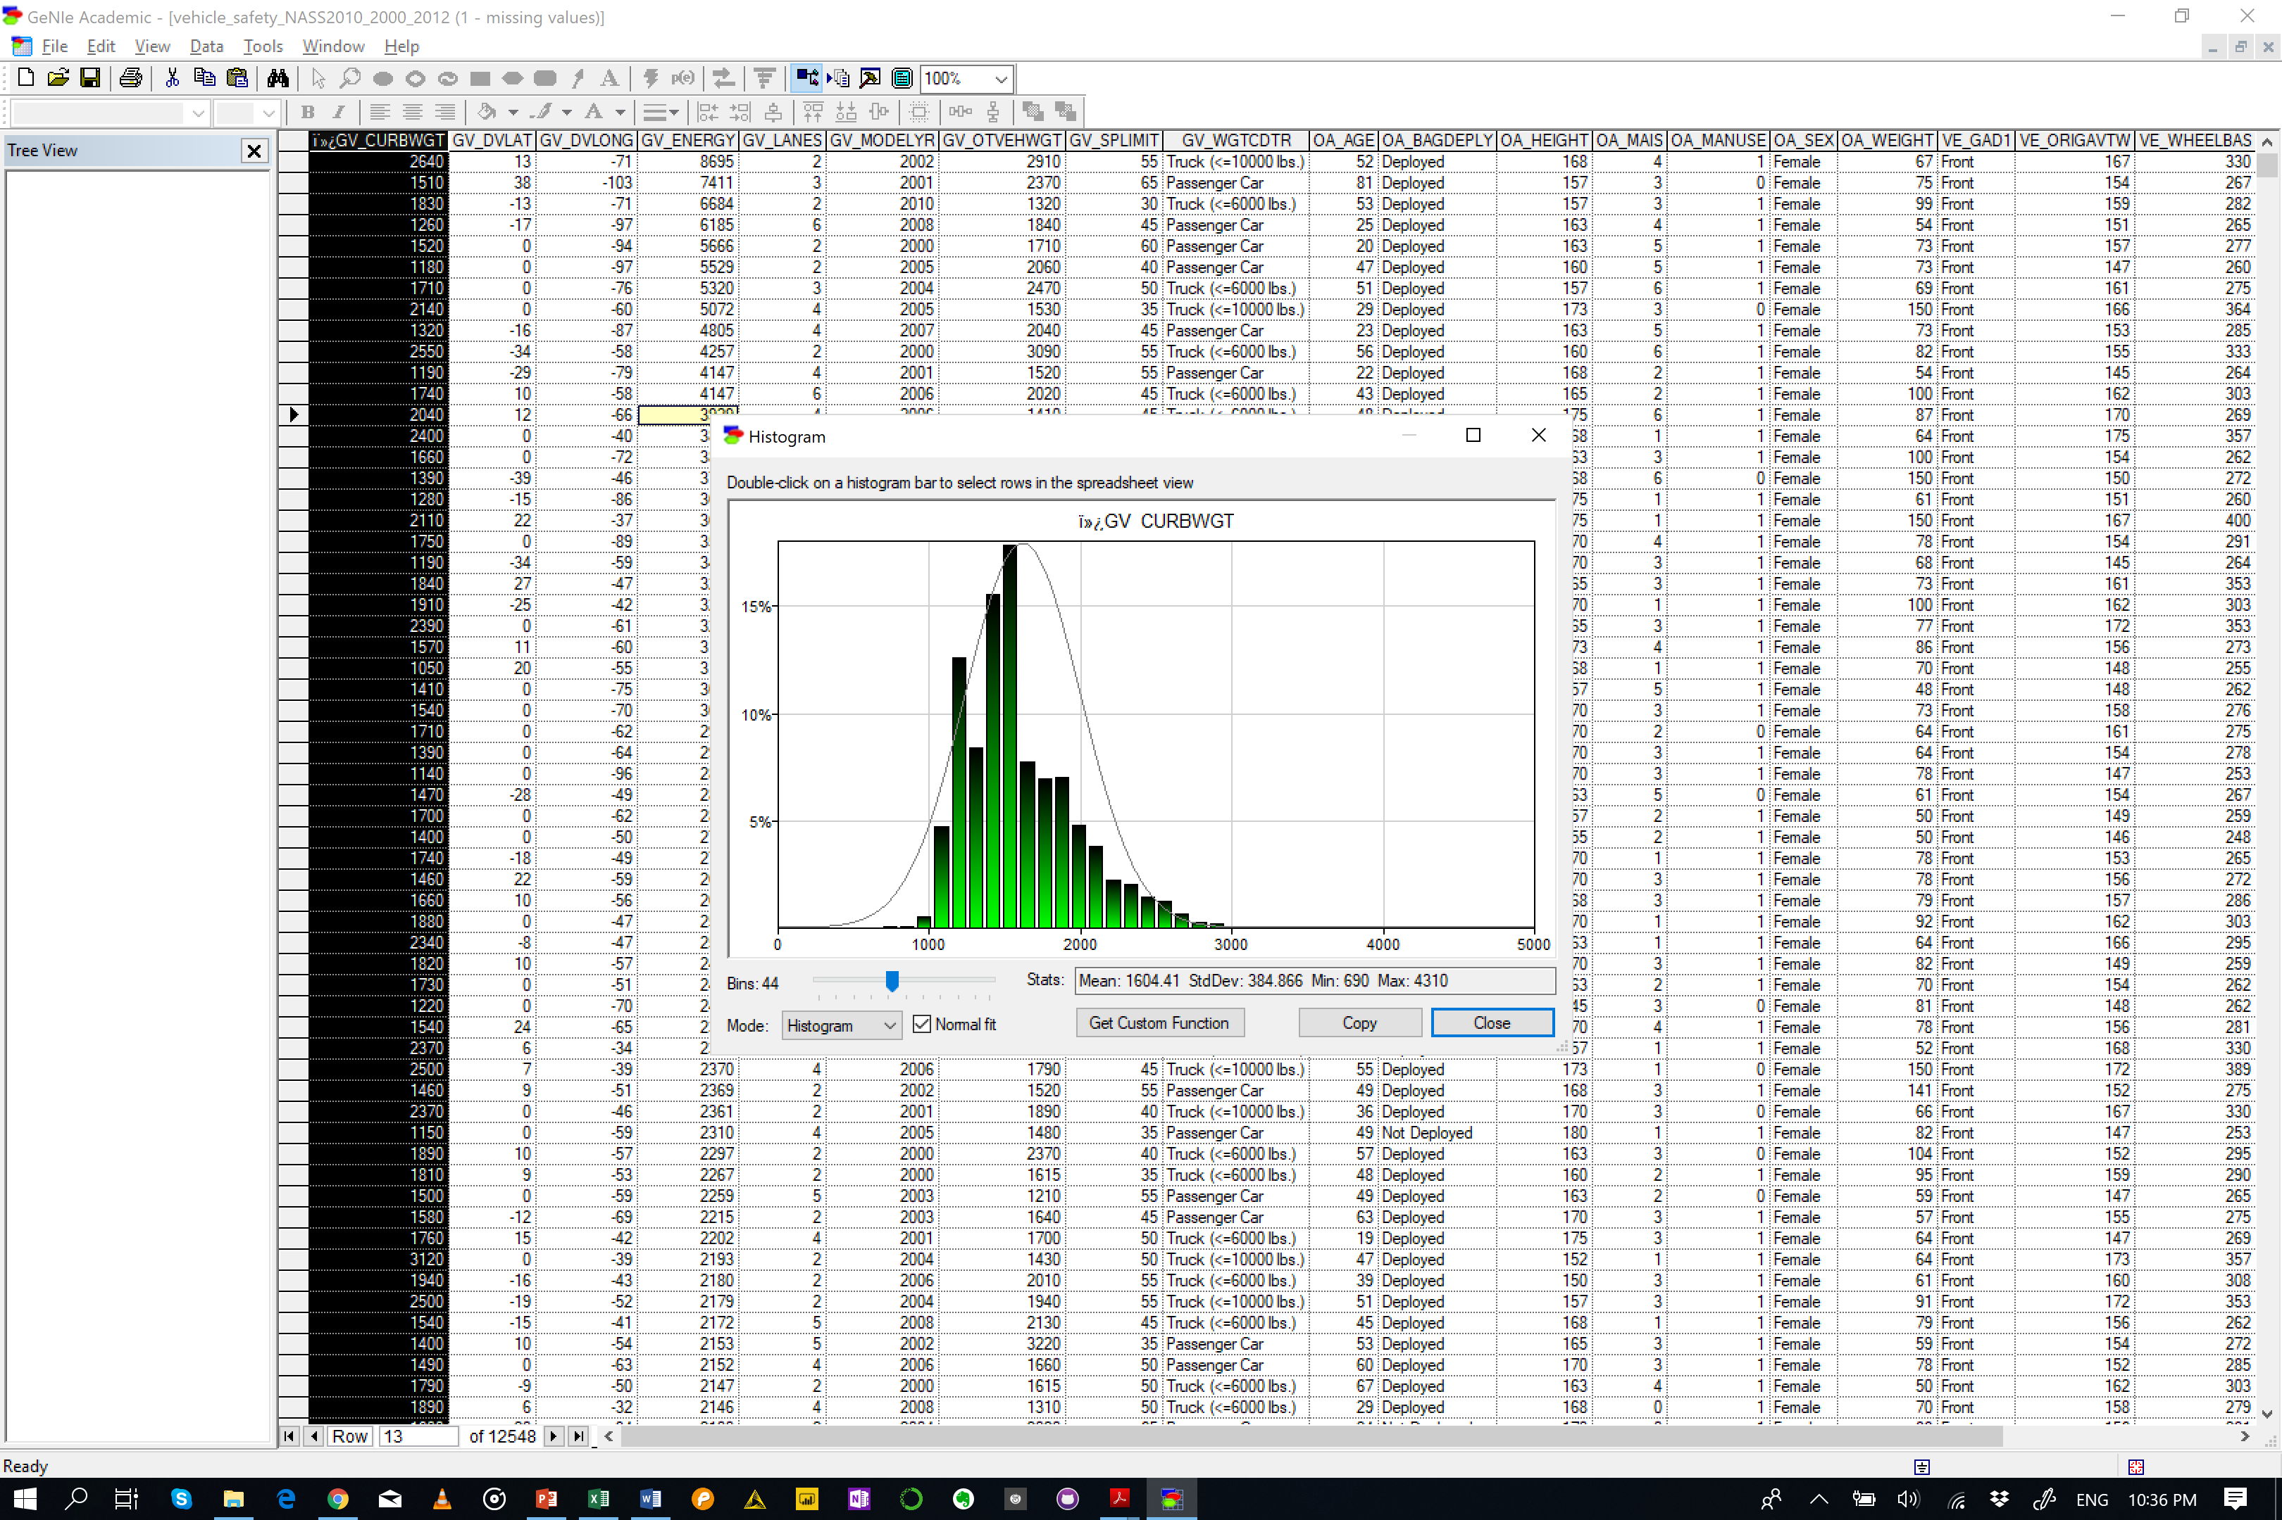
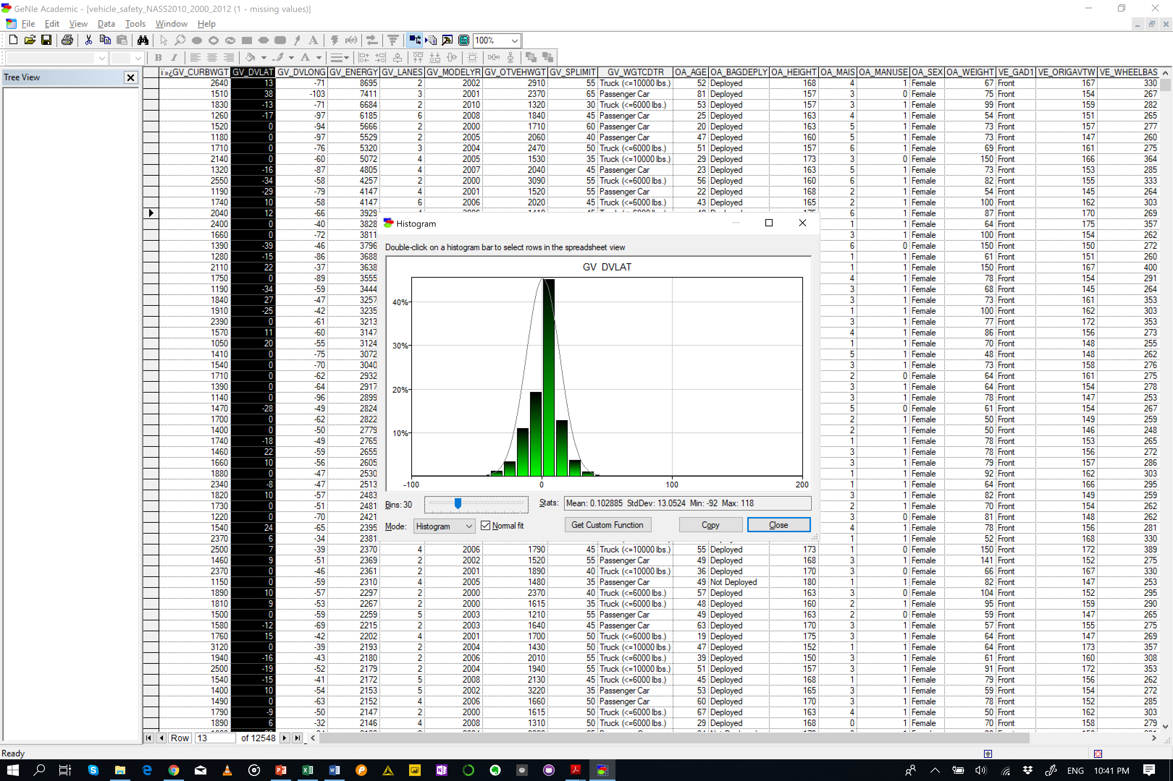
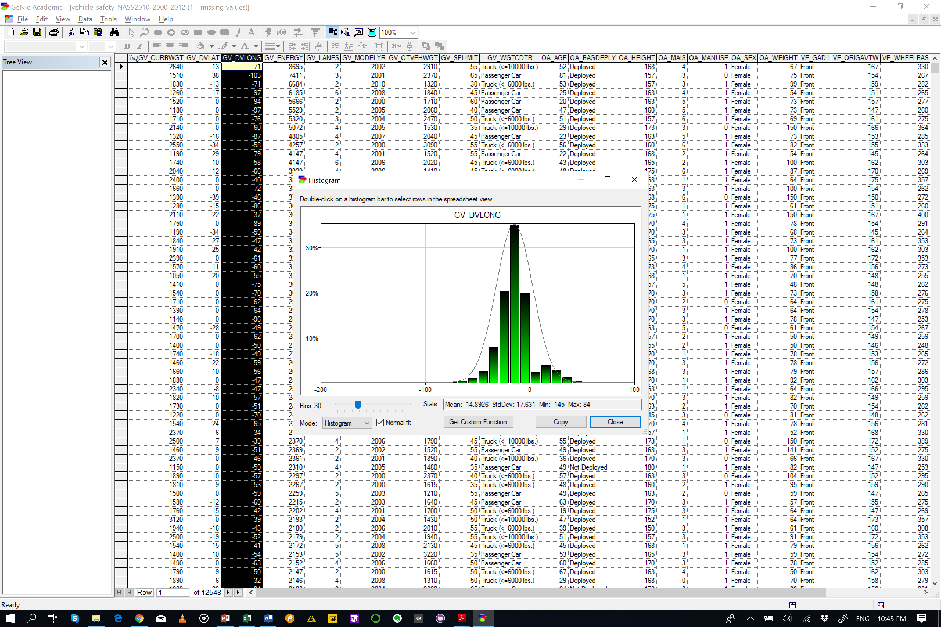
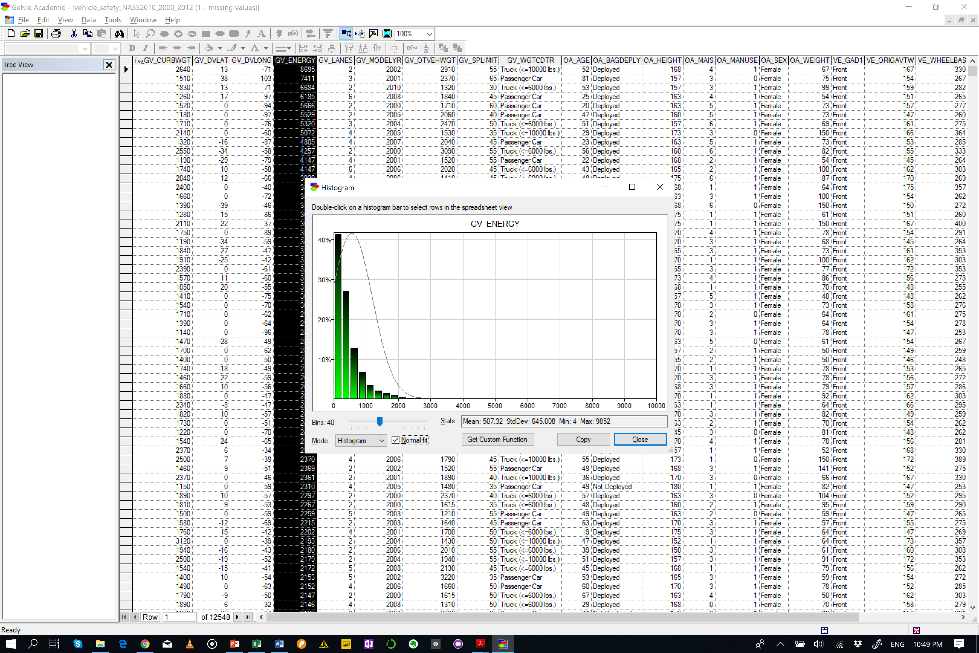
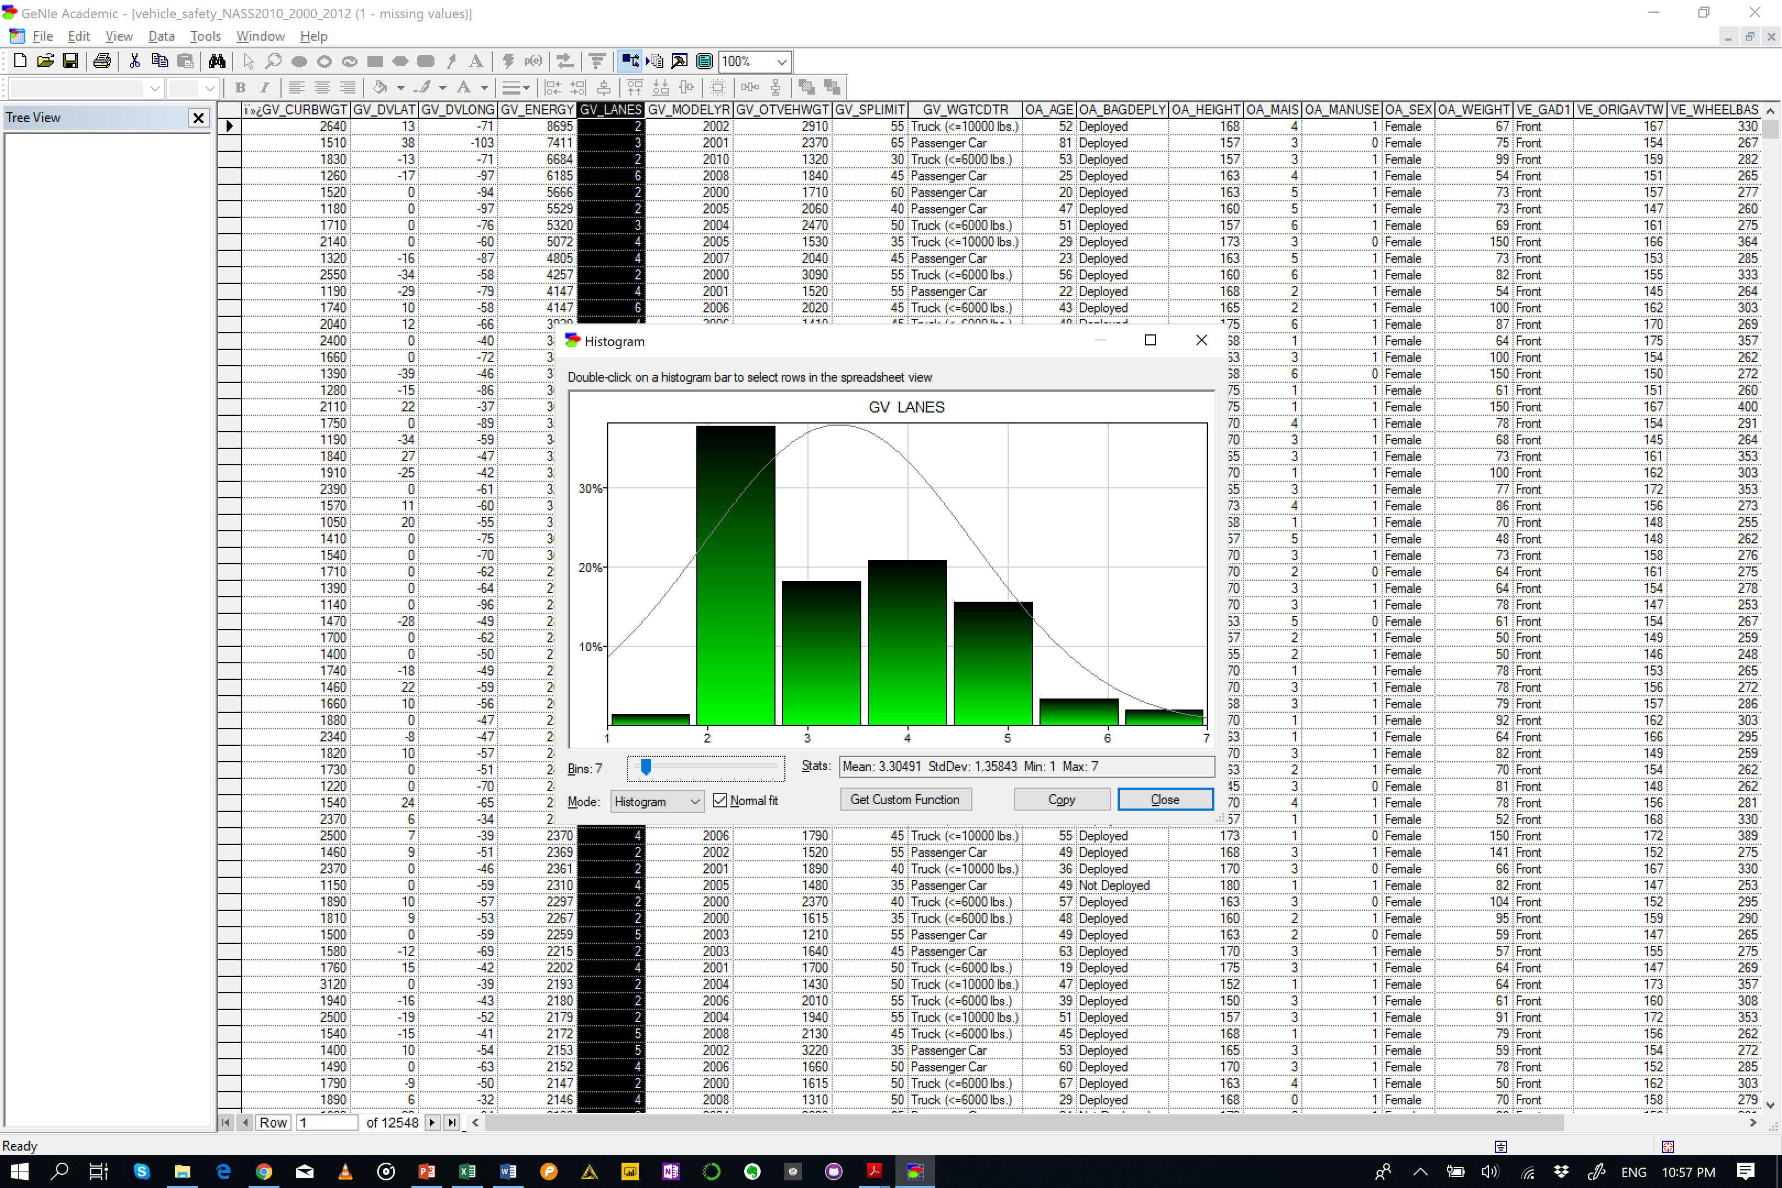
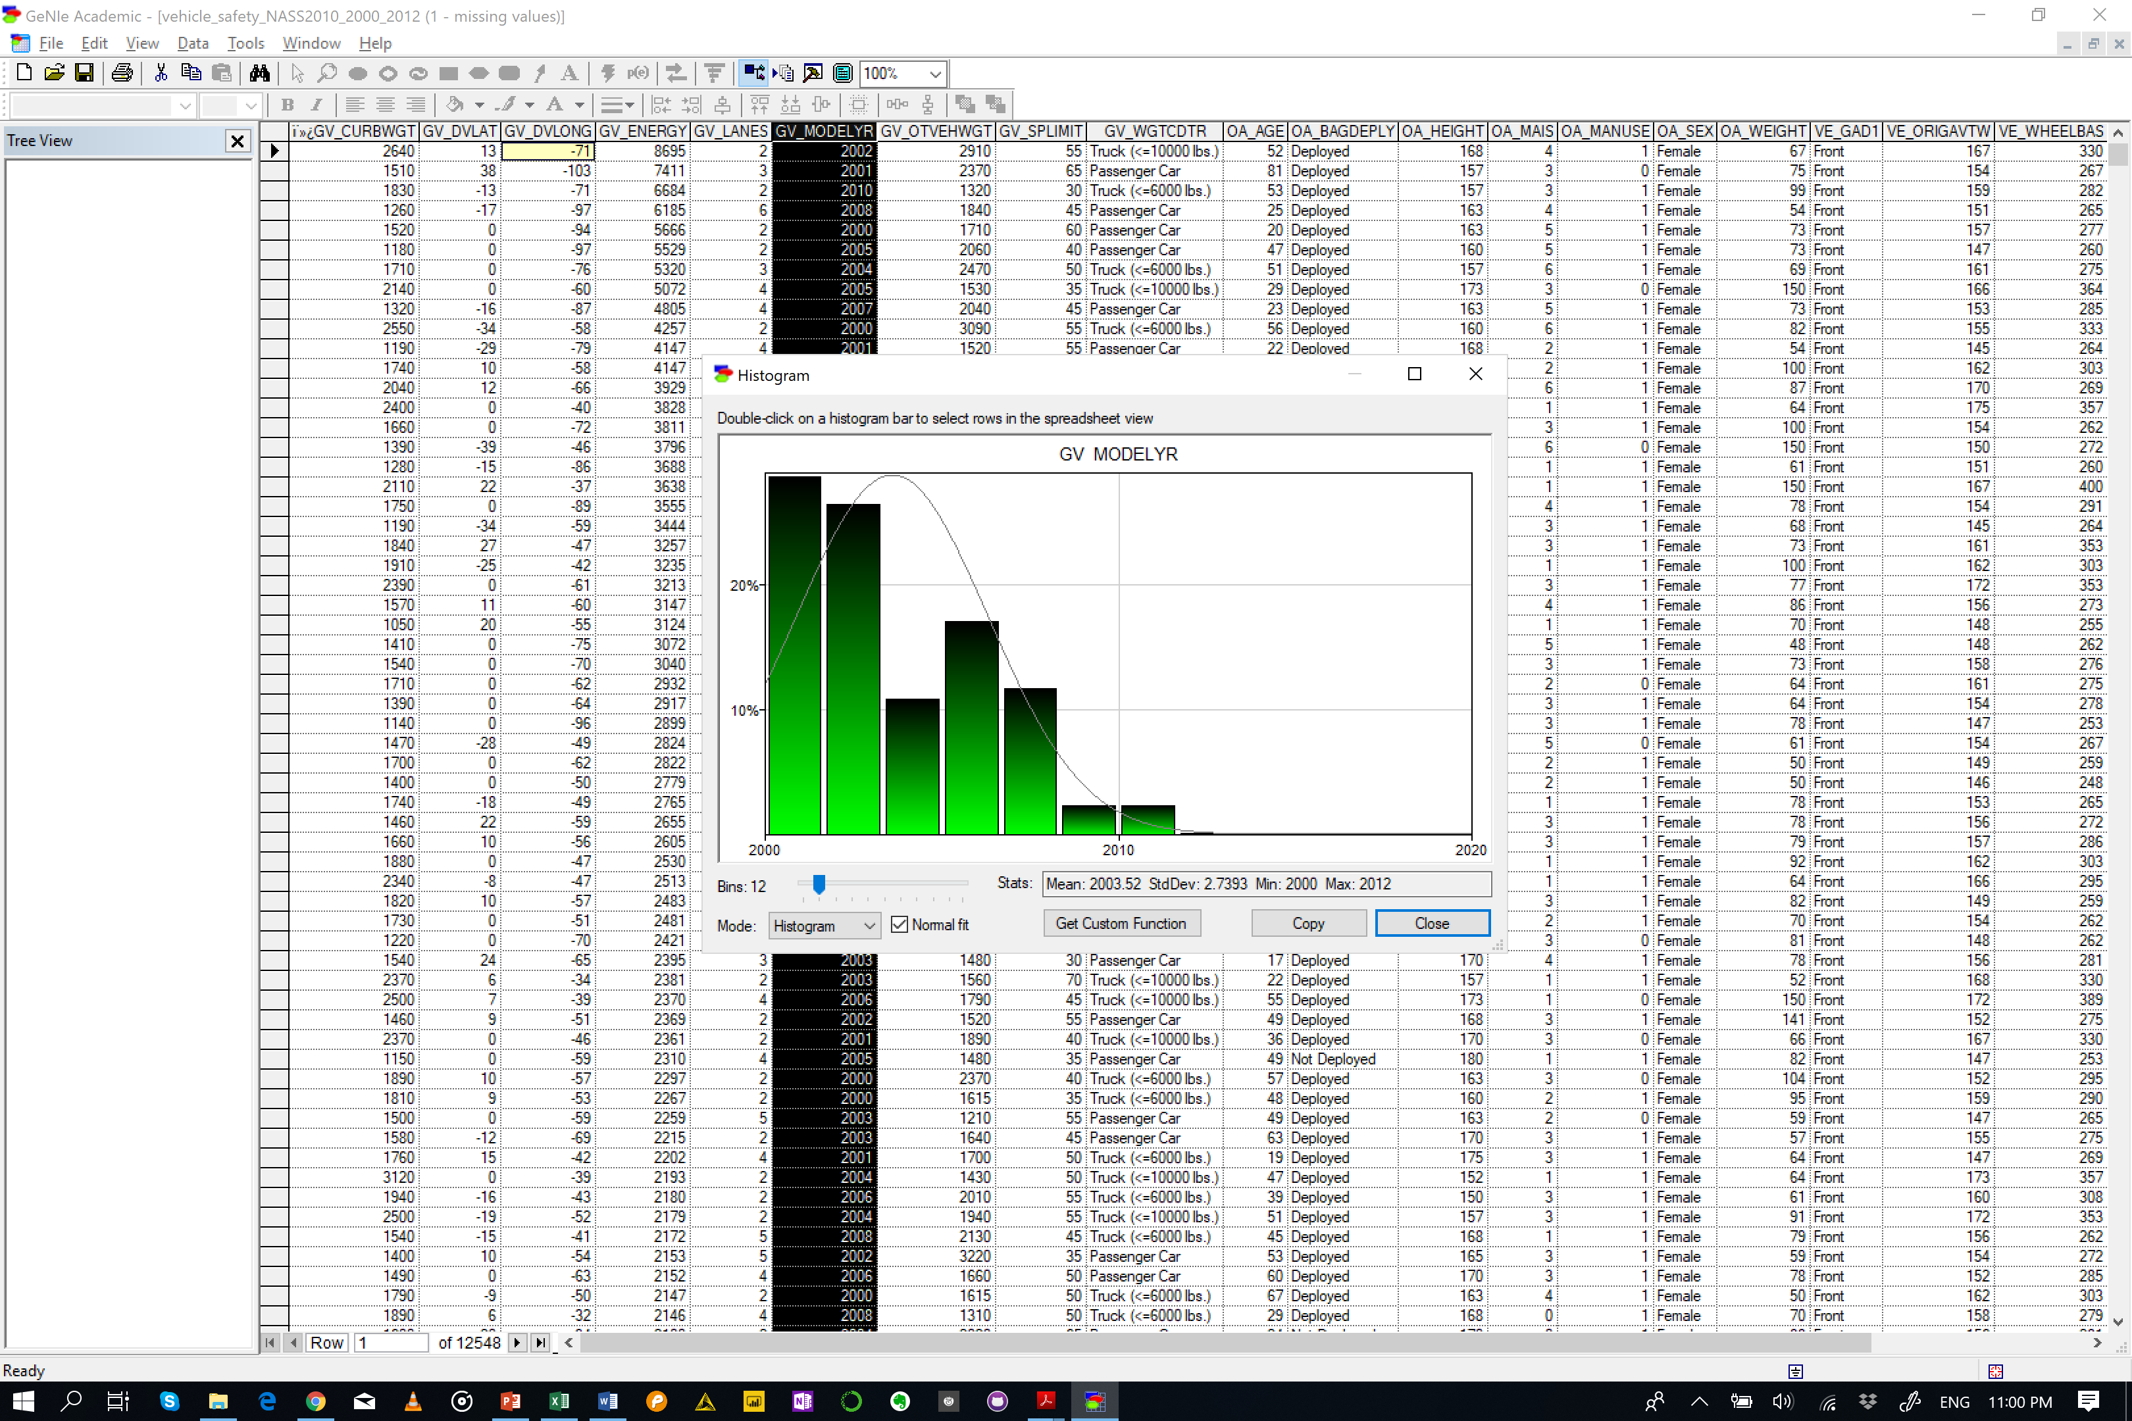
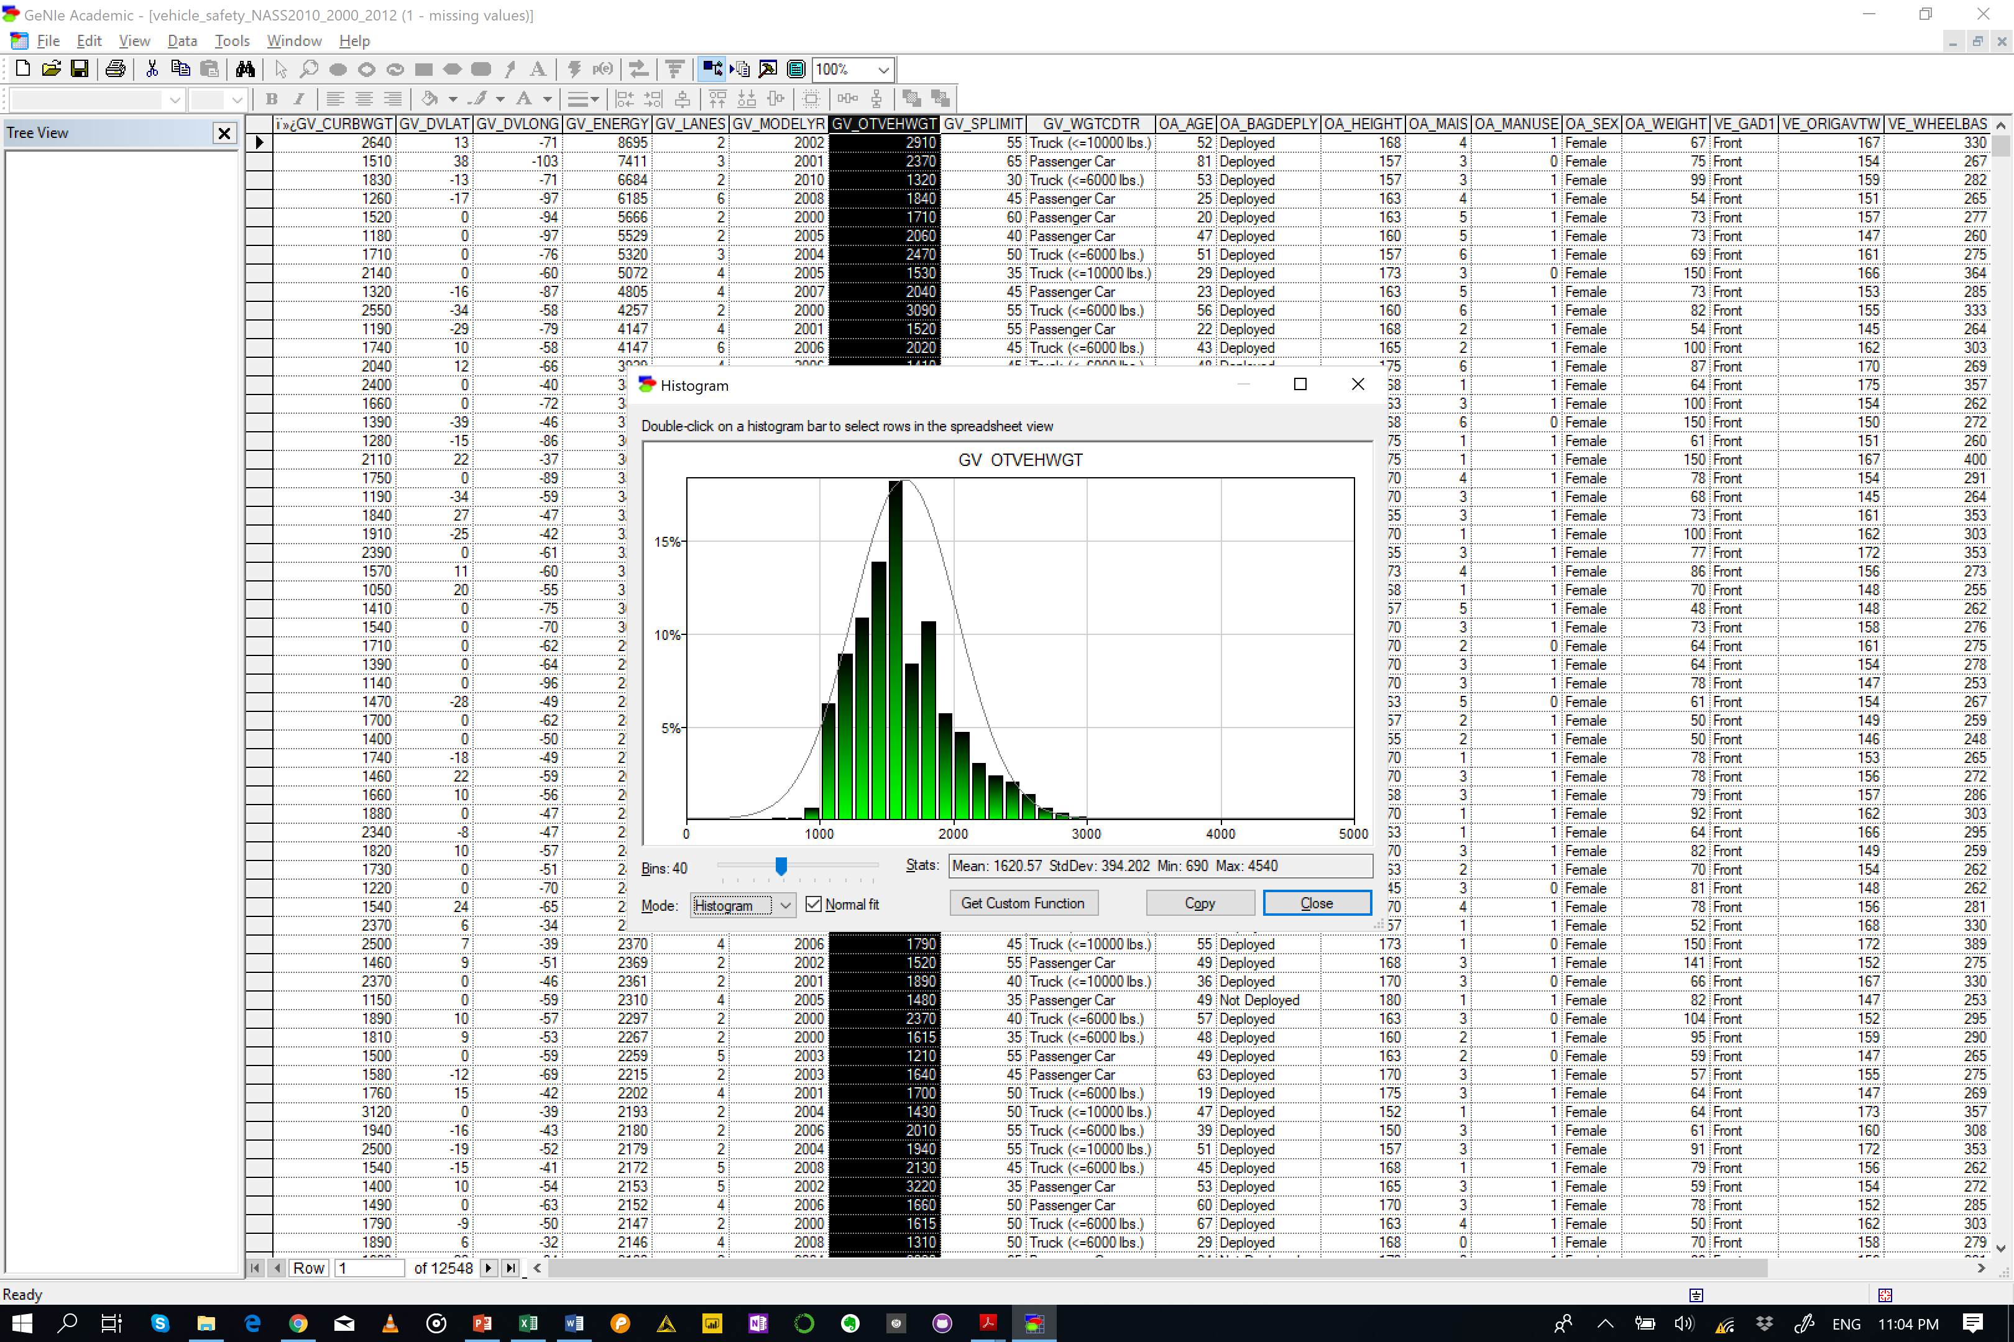
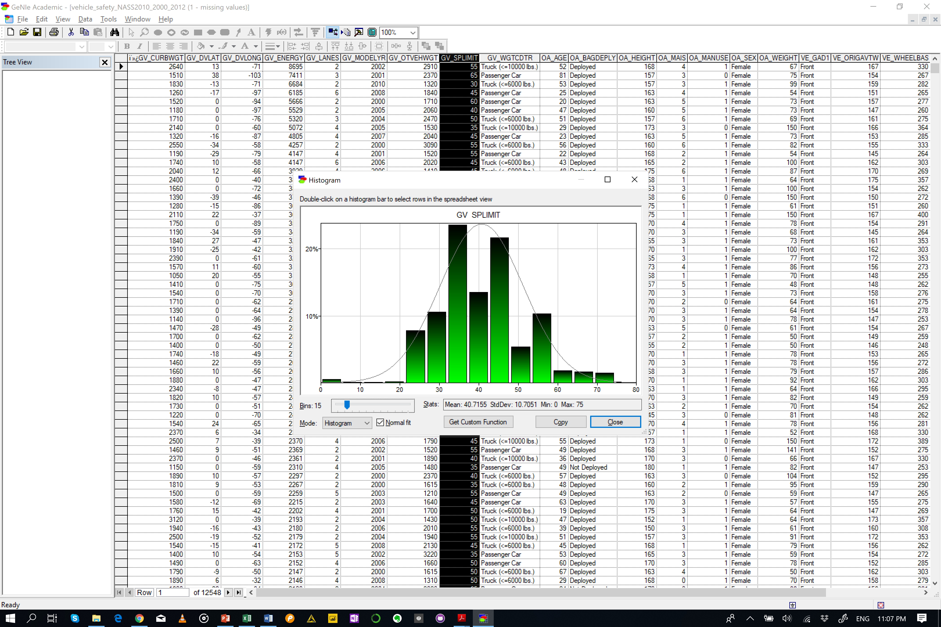
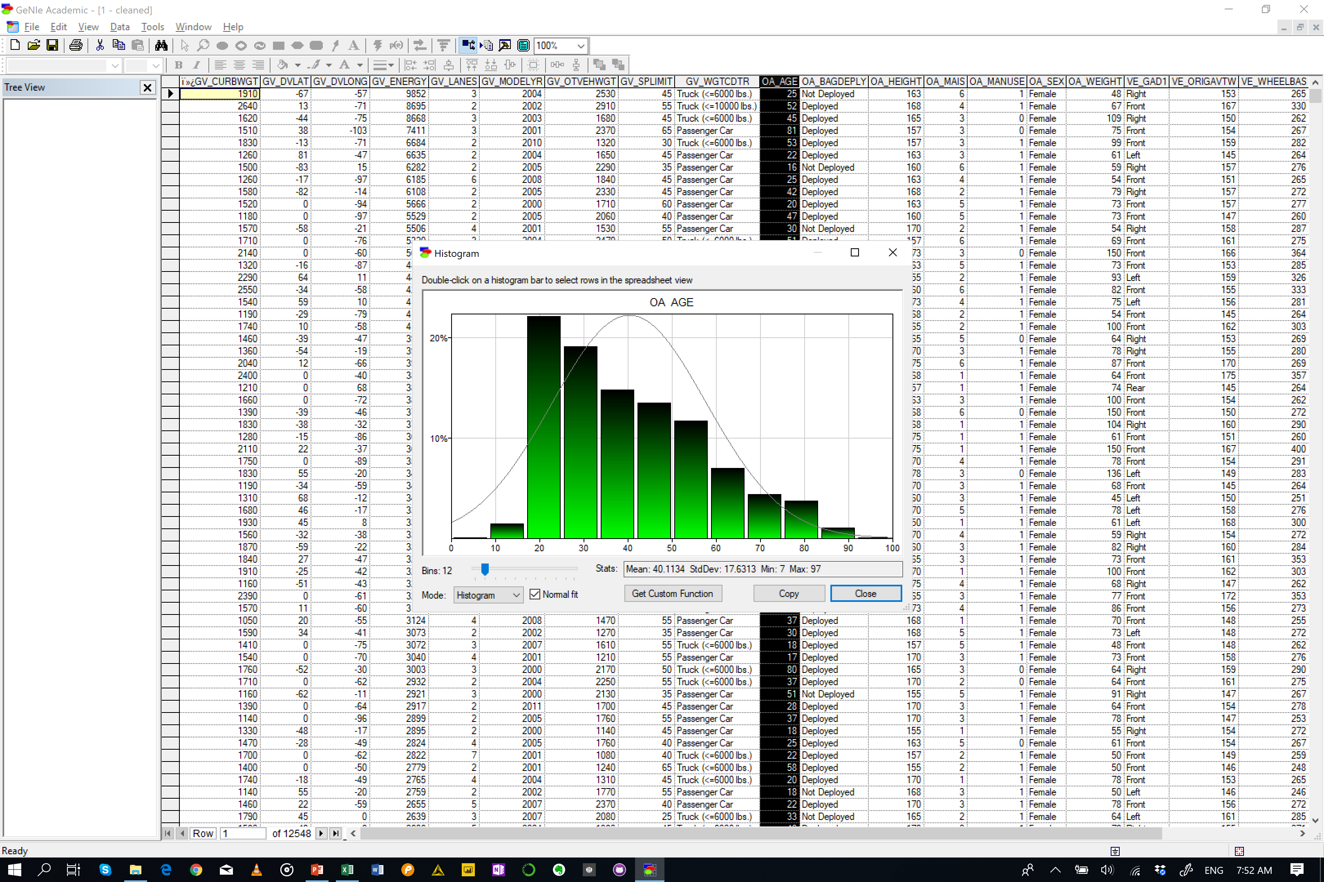
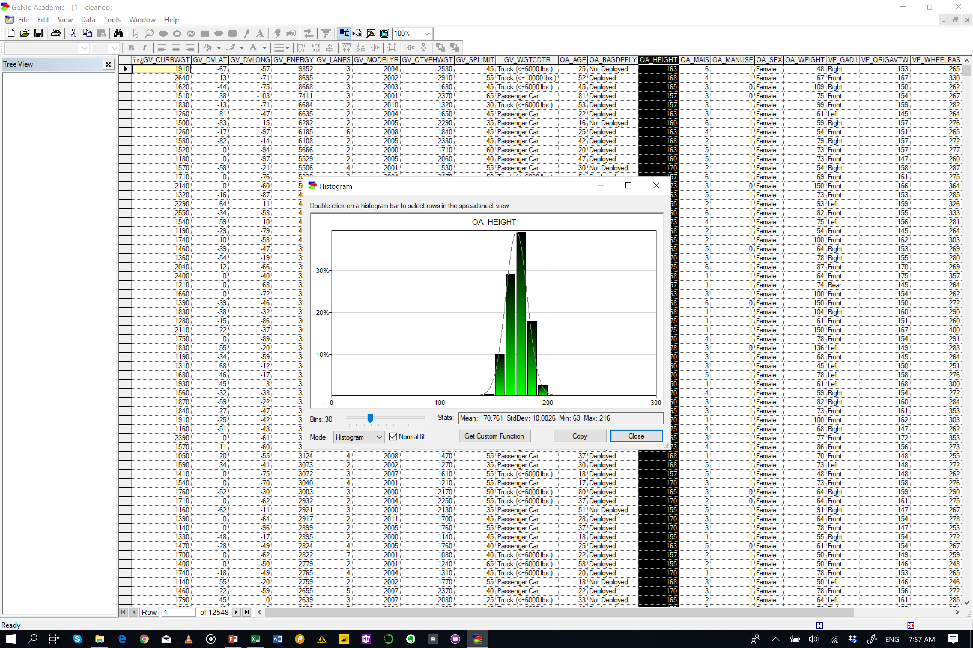
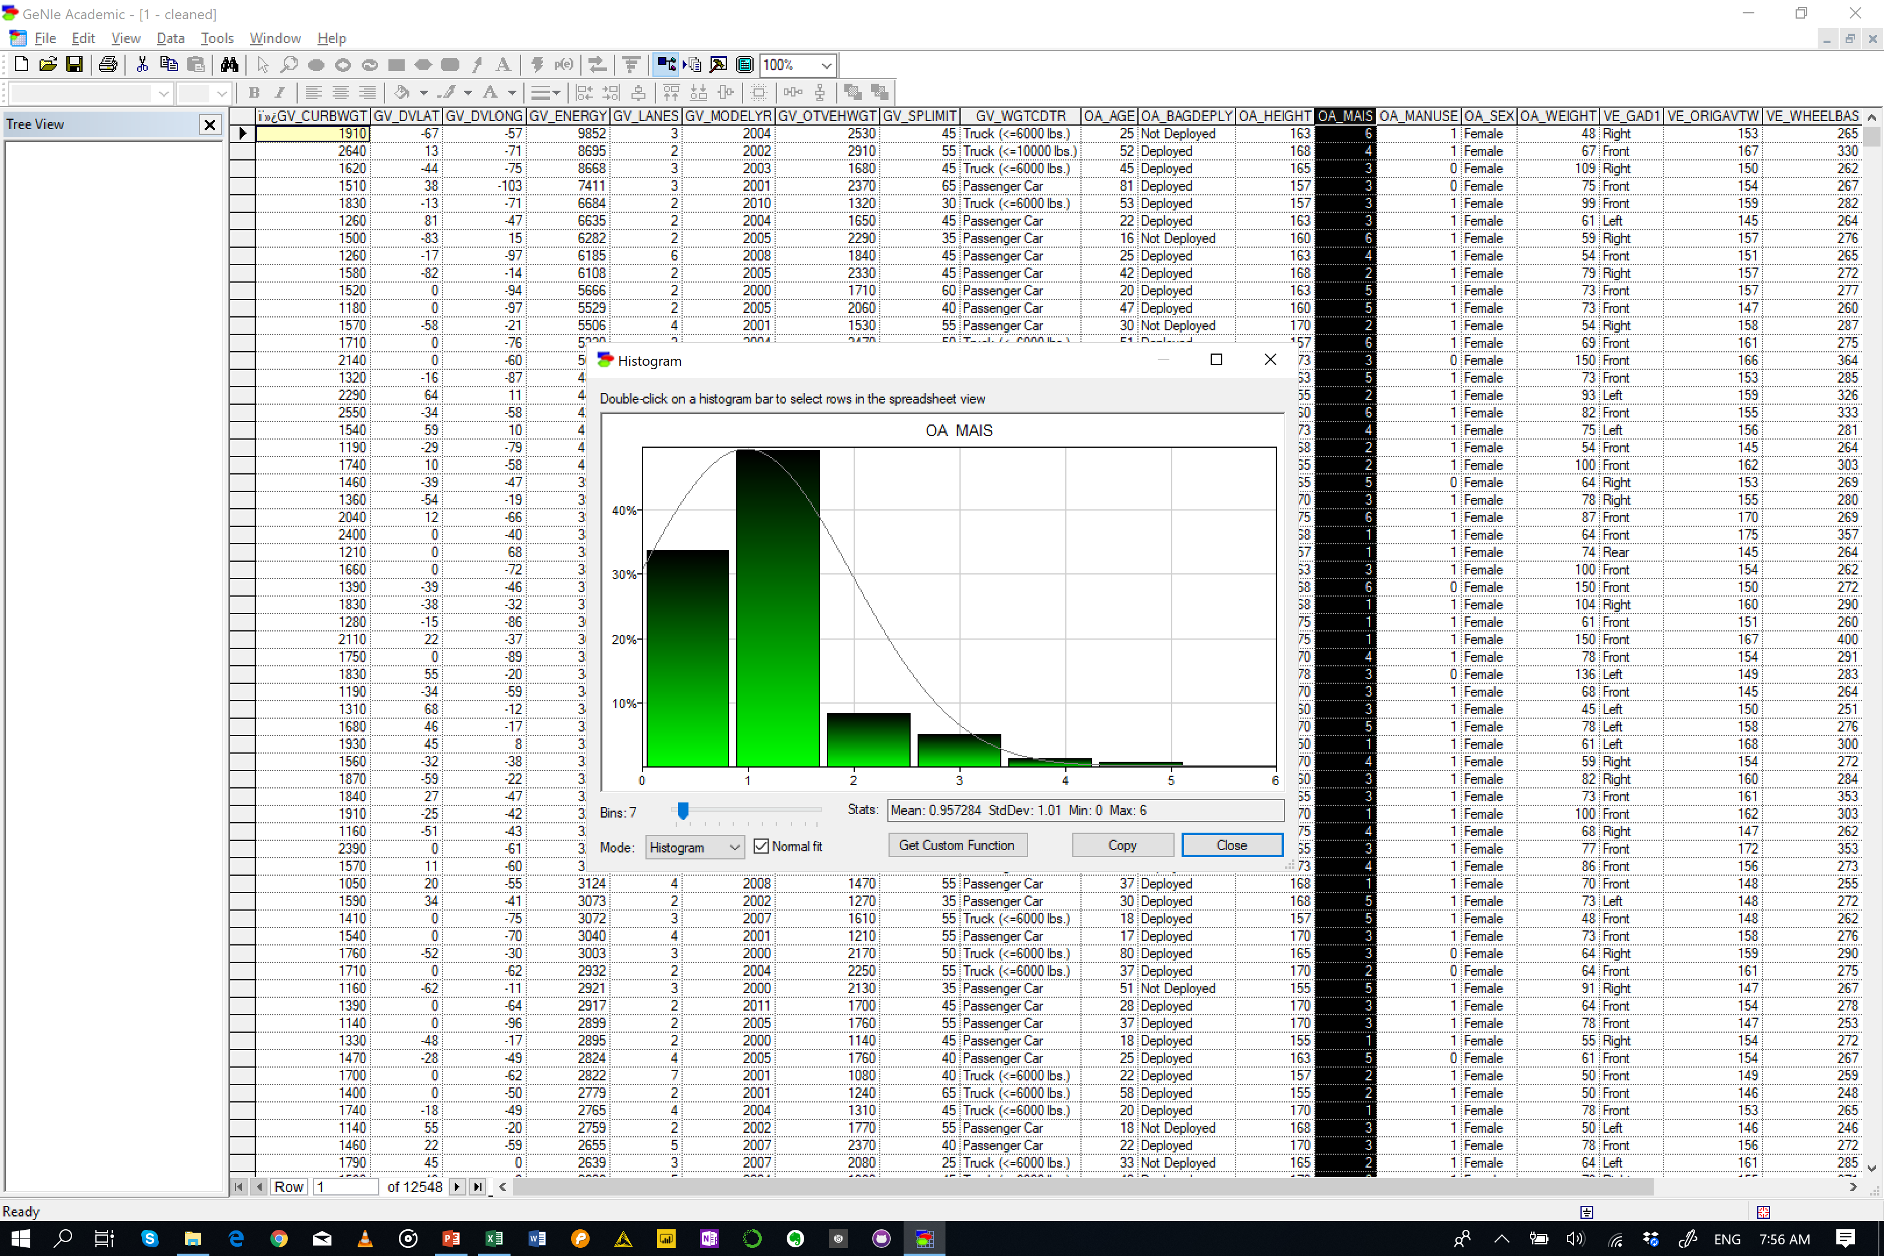
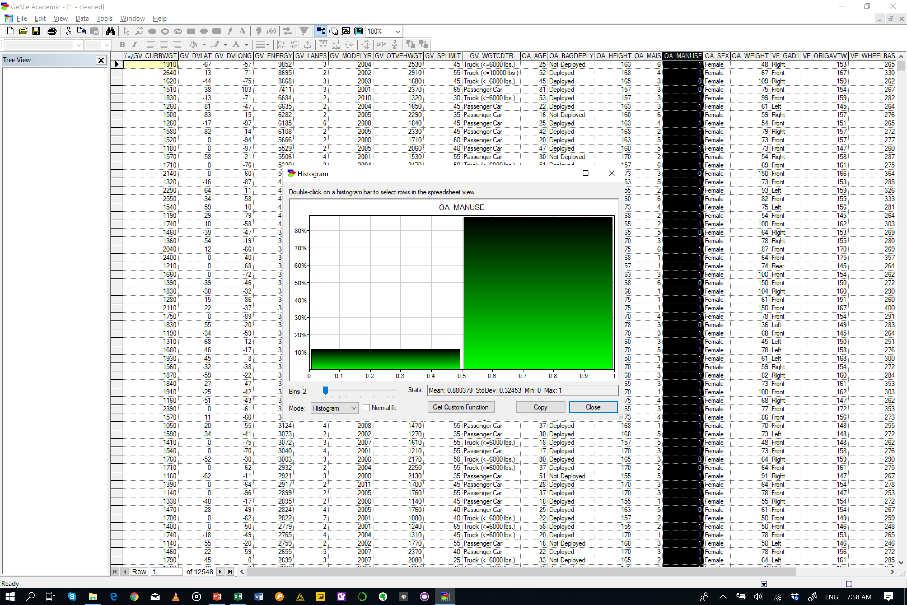

Slide 2
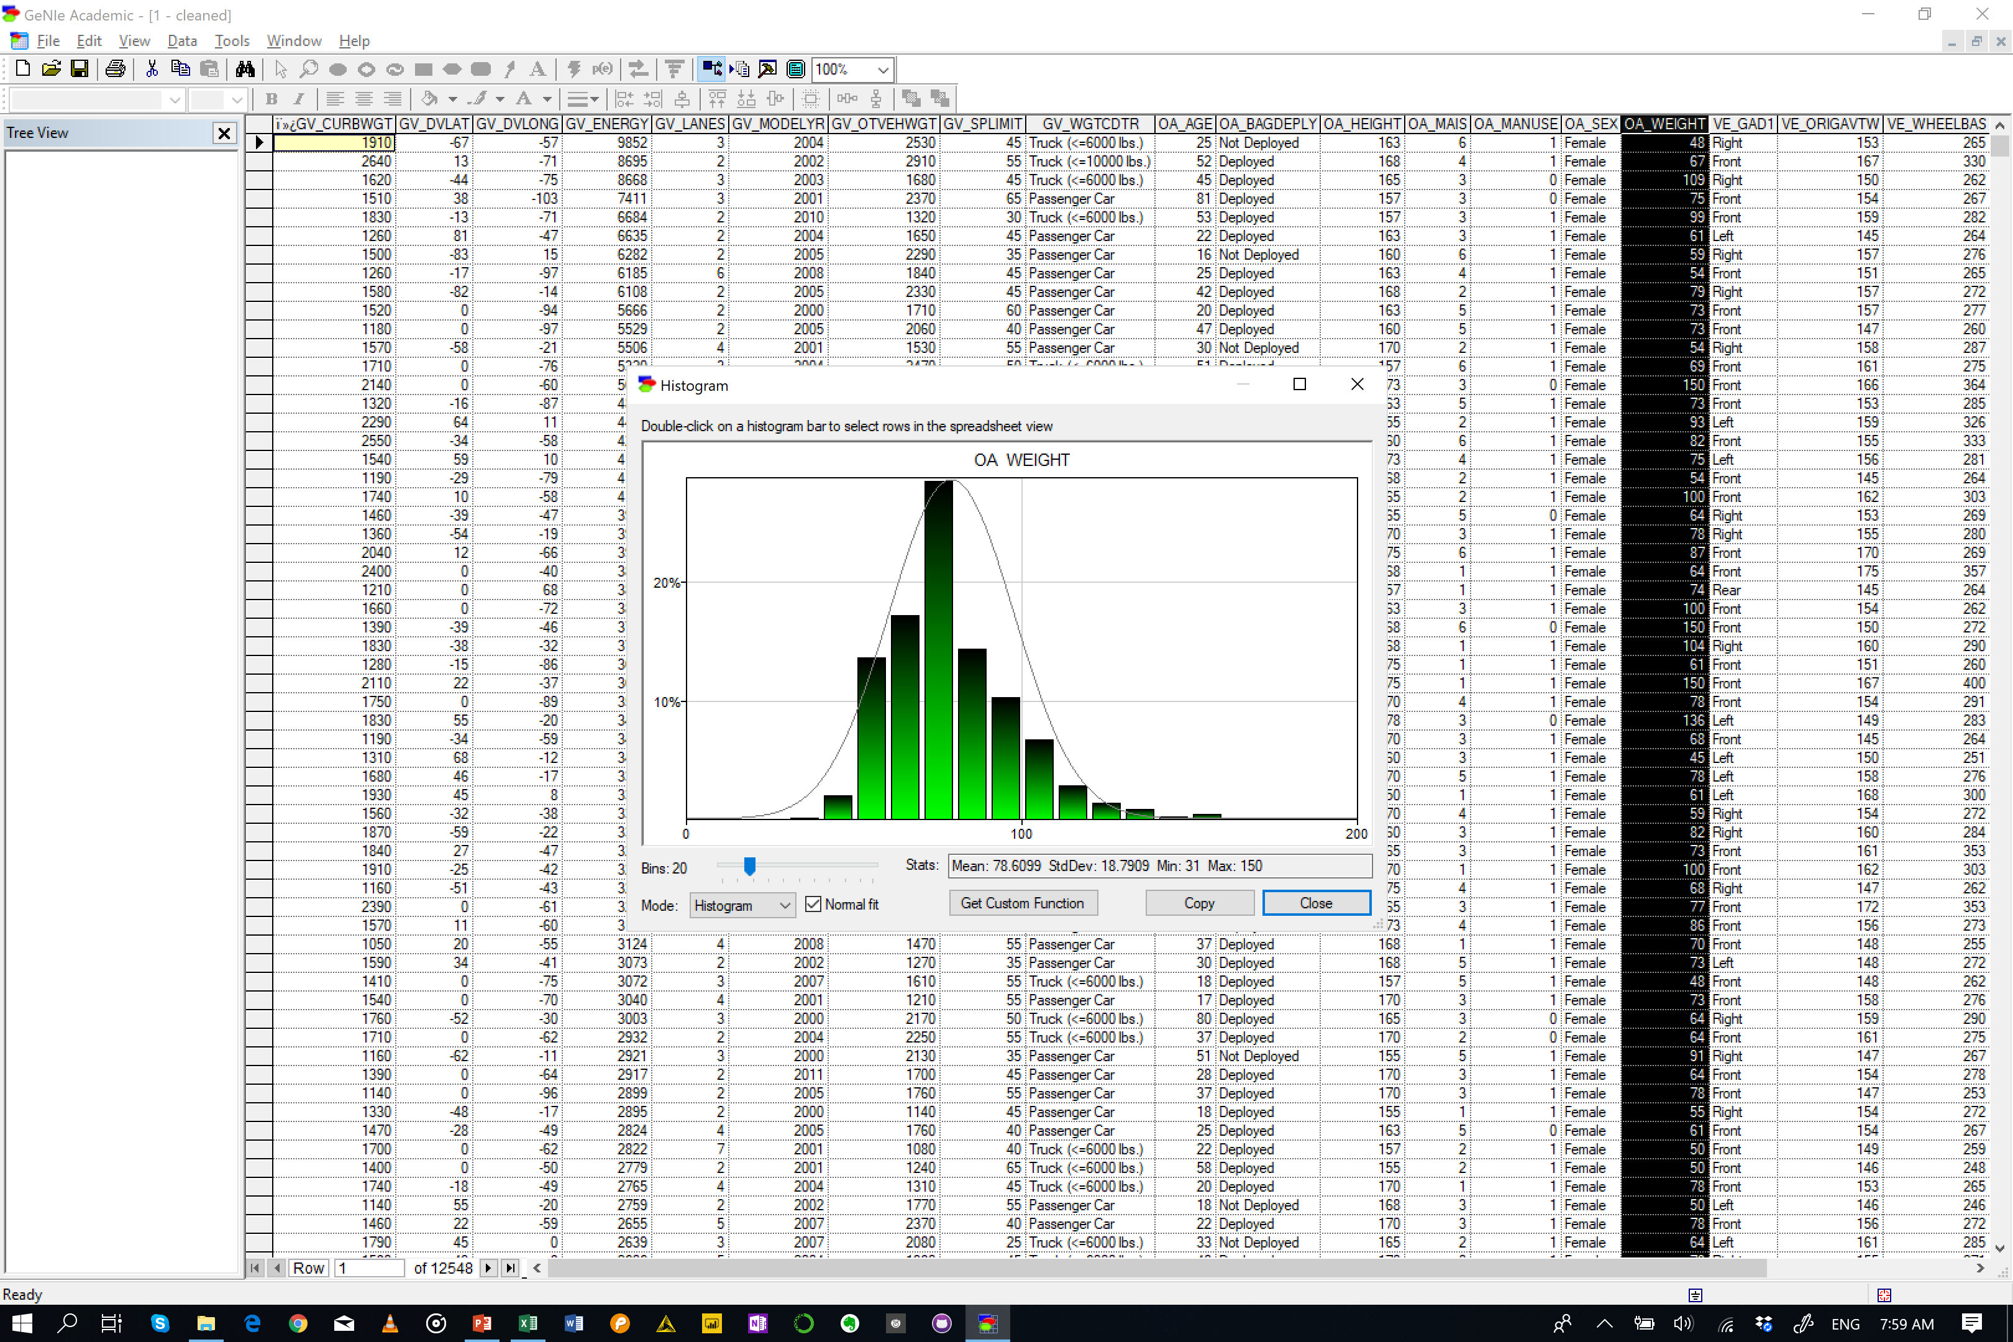
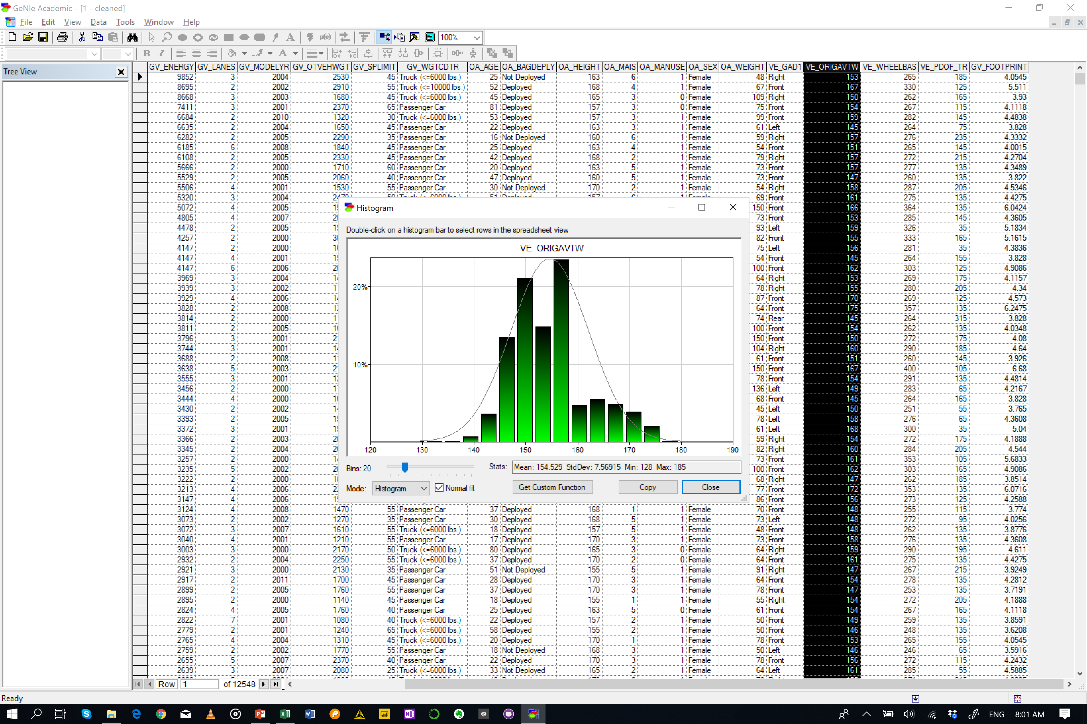
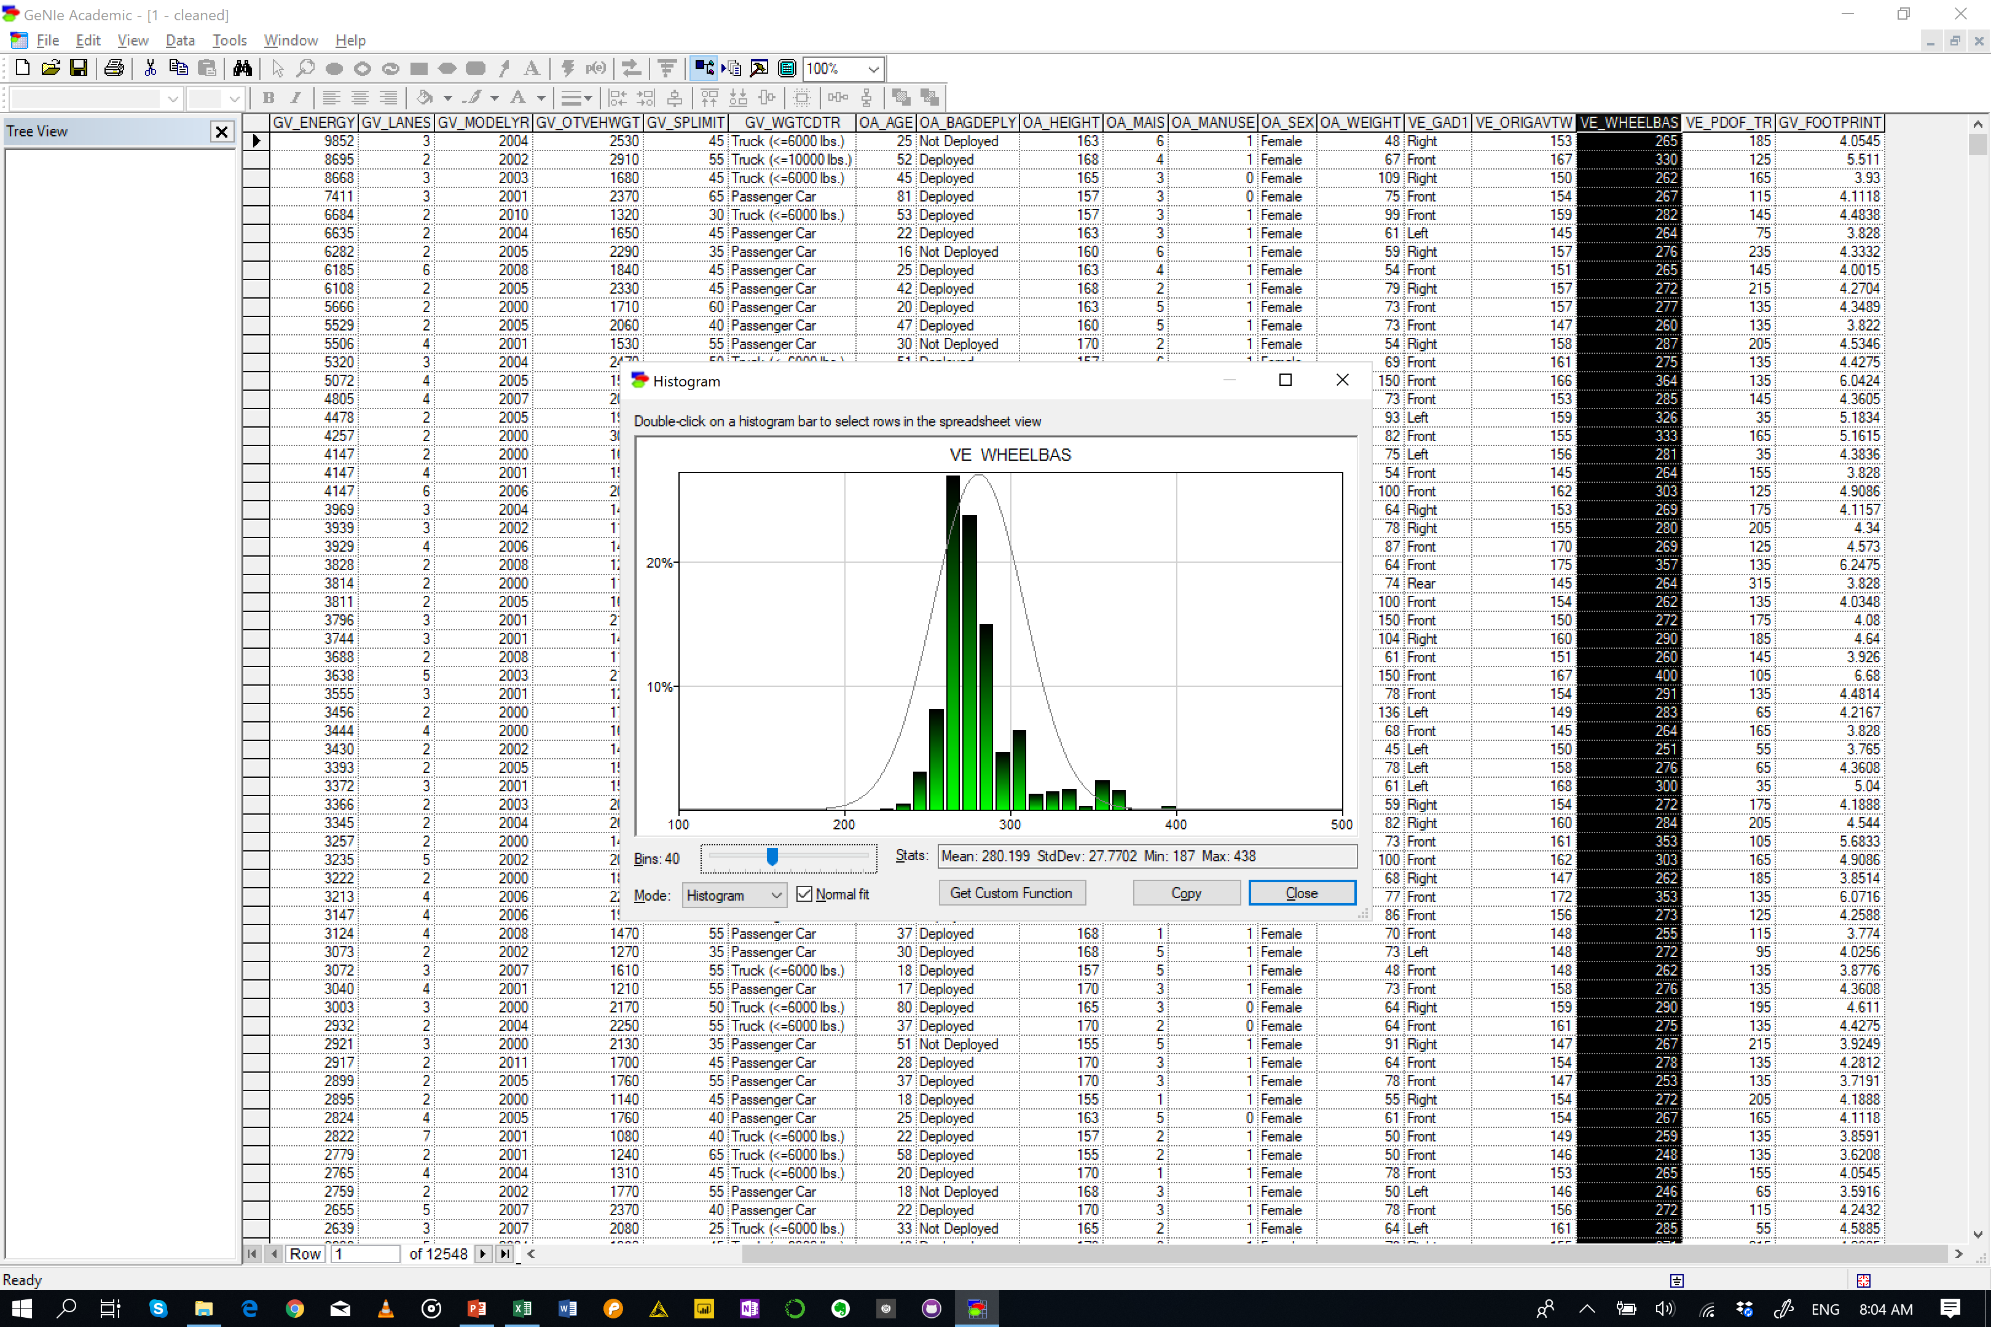
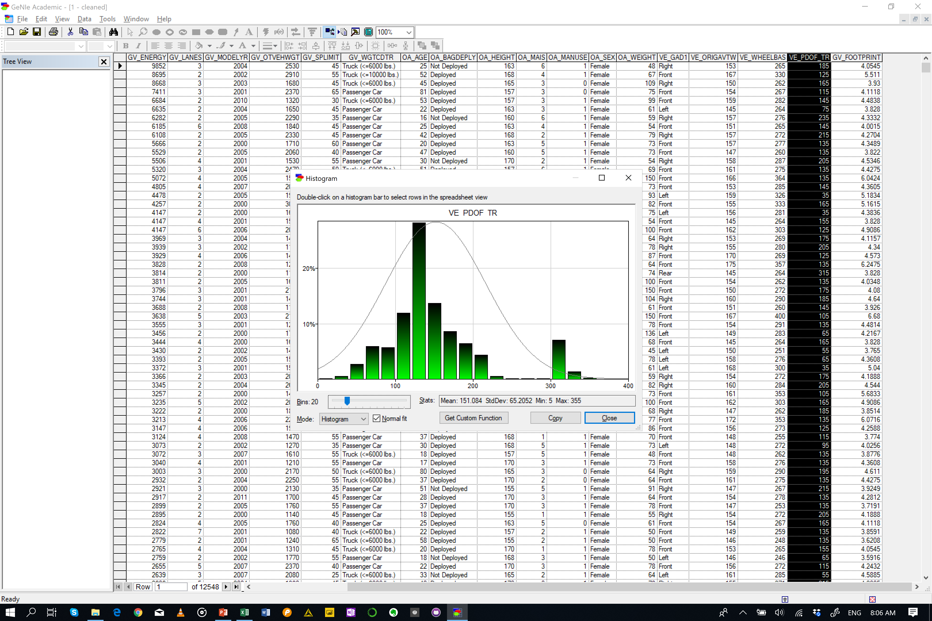
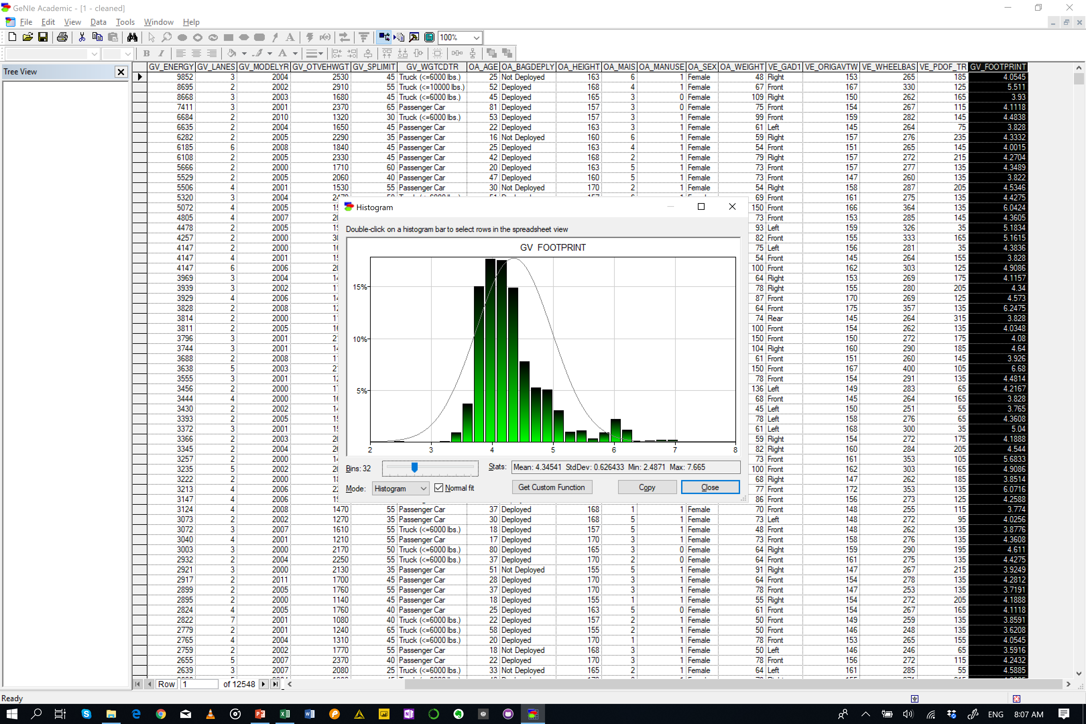

Slide 3
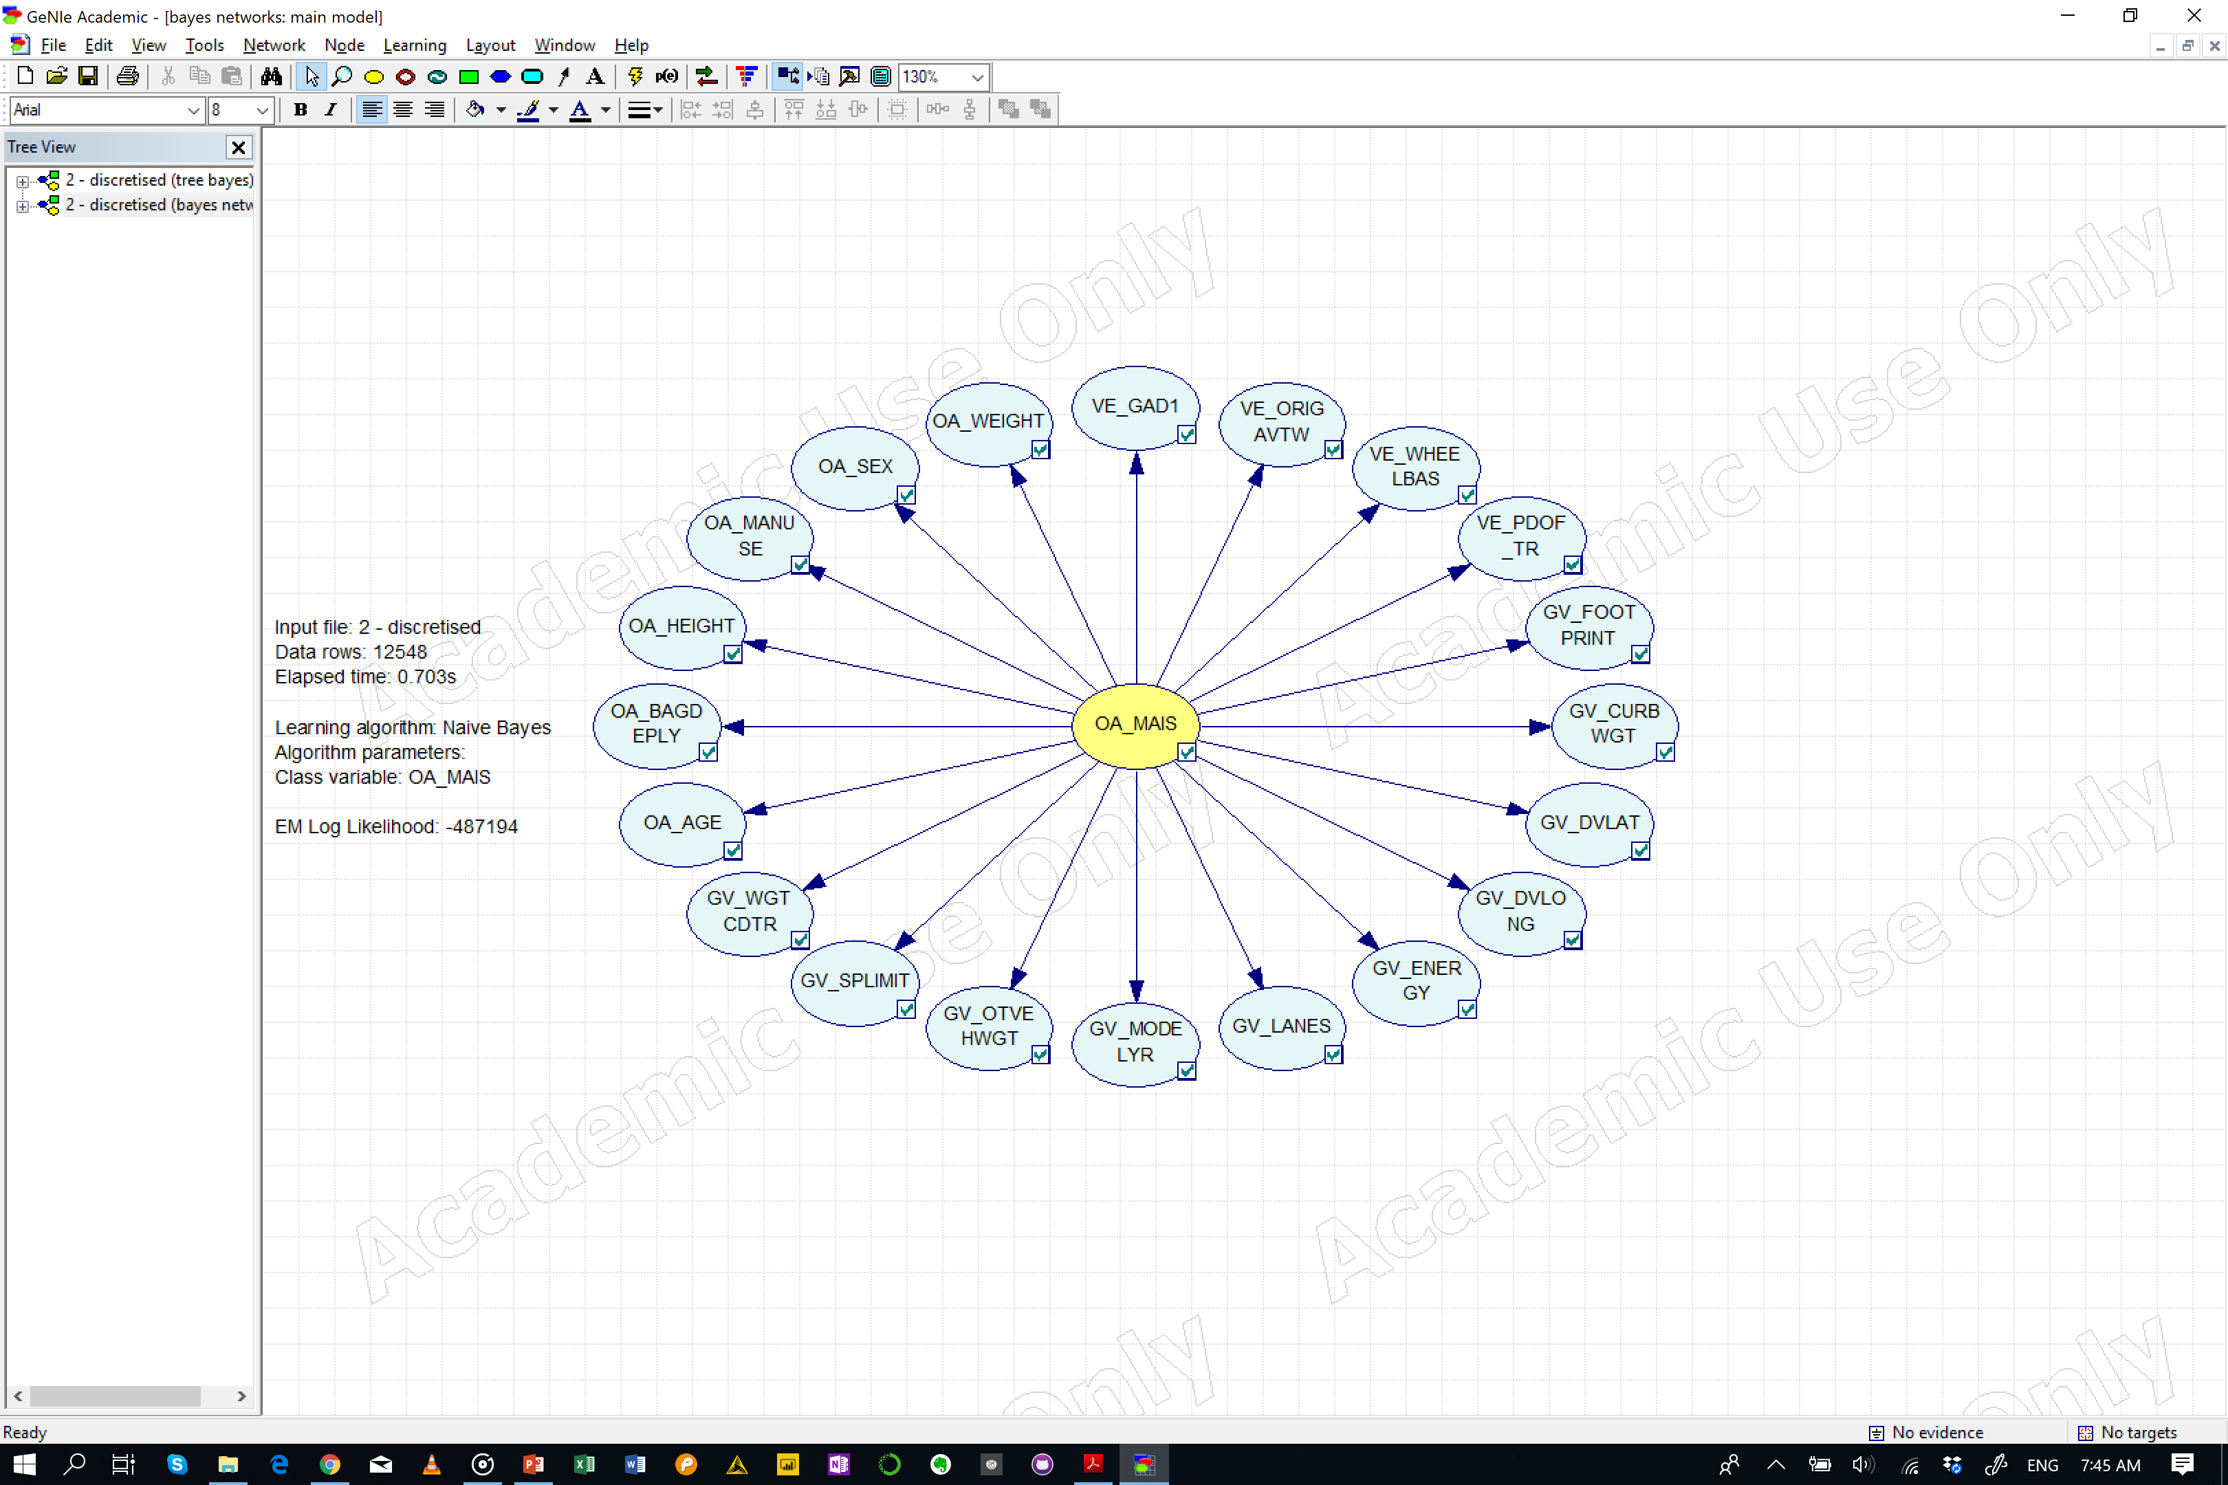
Naïve Bayes

Slide 4
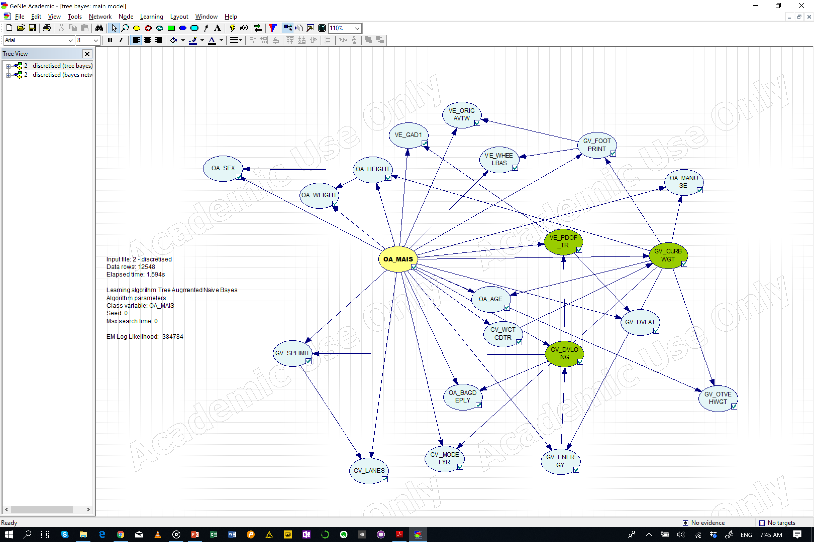
Tree Augmented Bayesian Networks

Slide 5
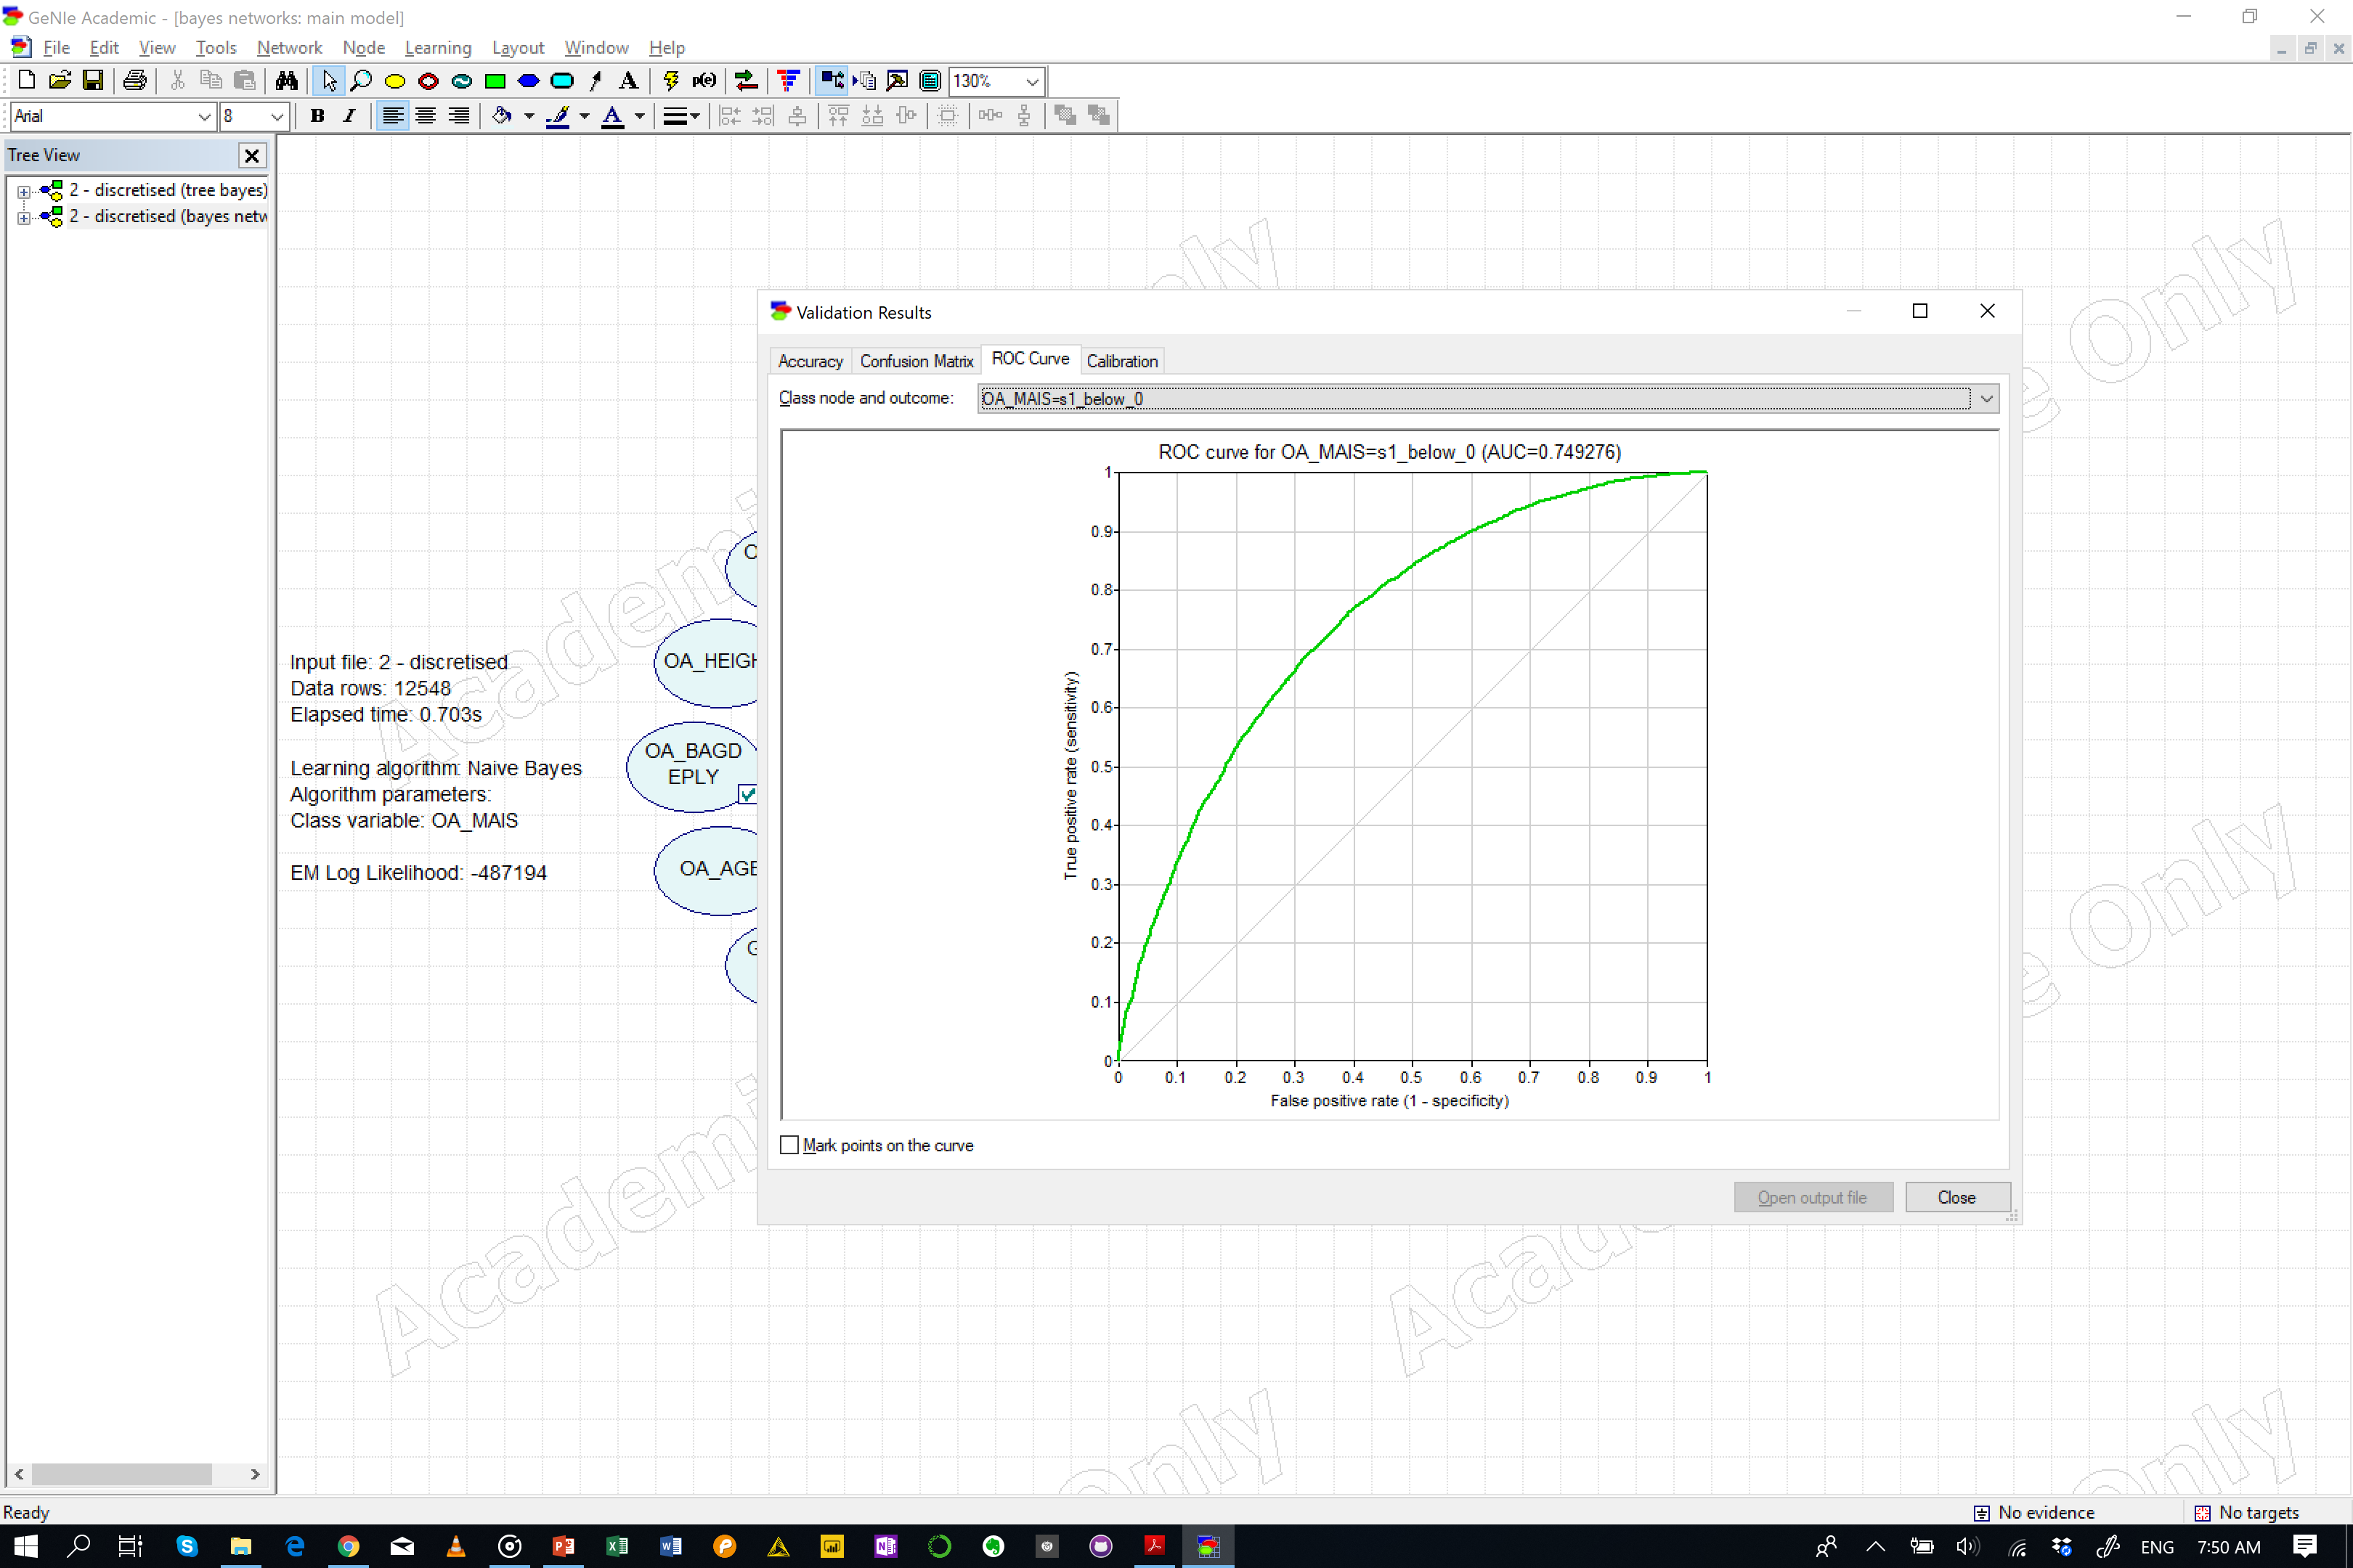
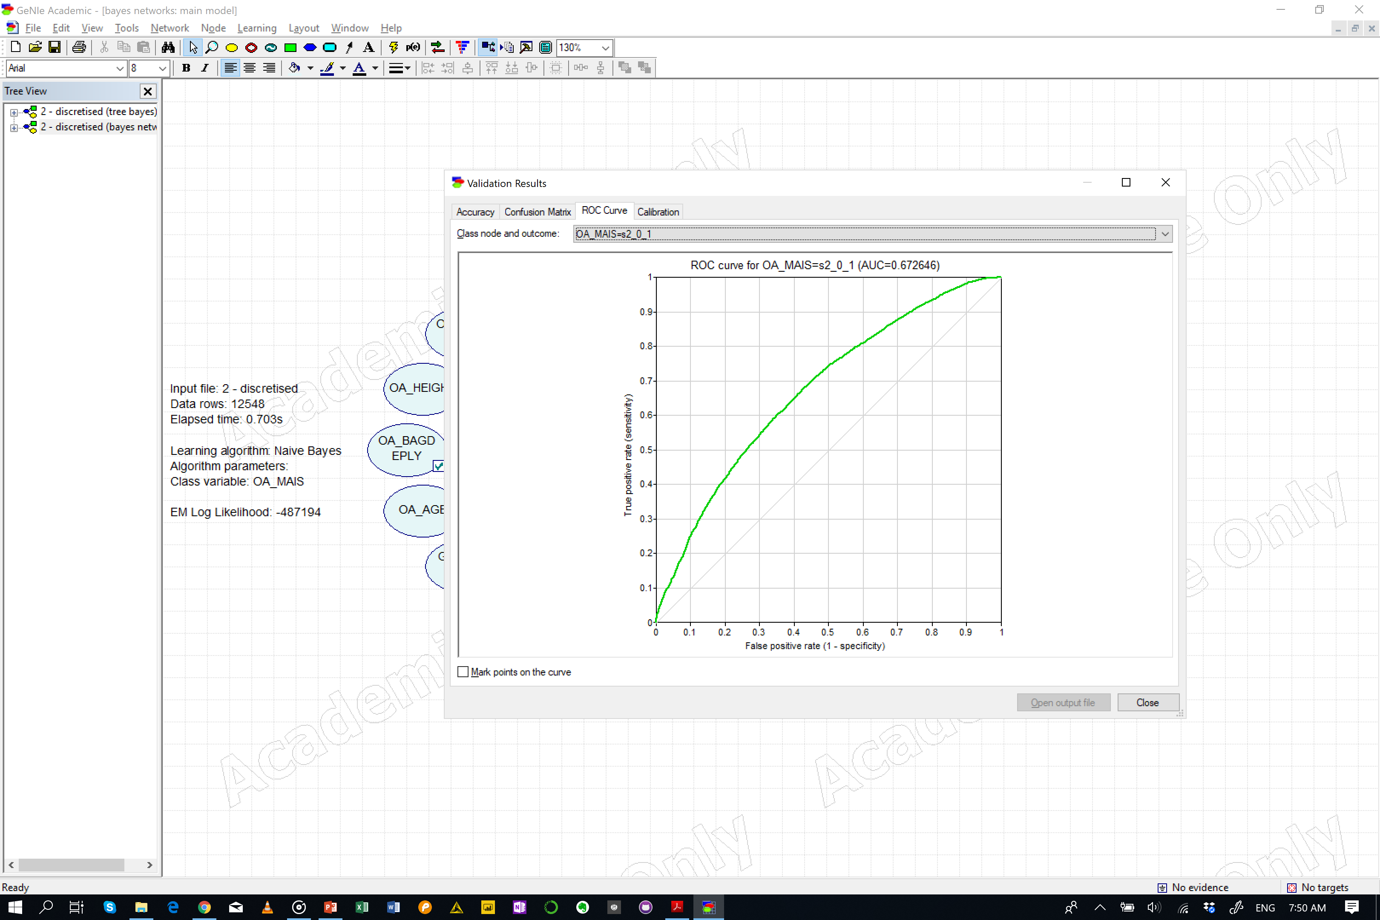
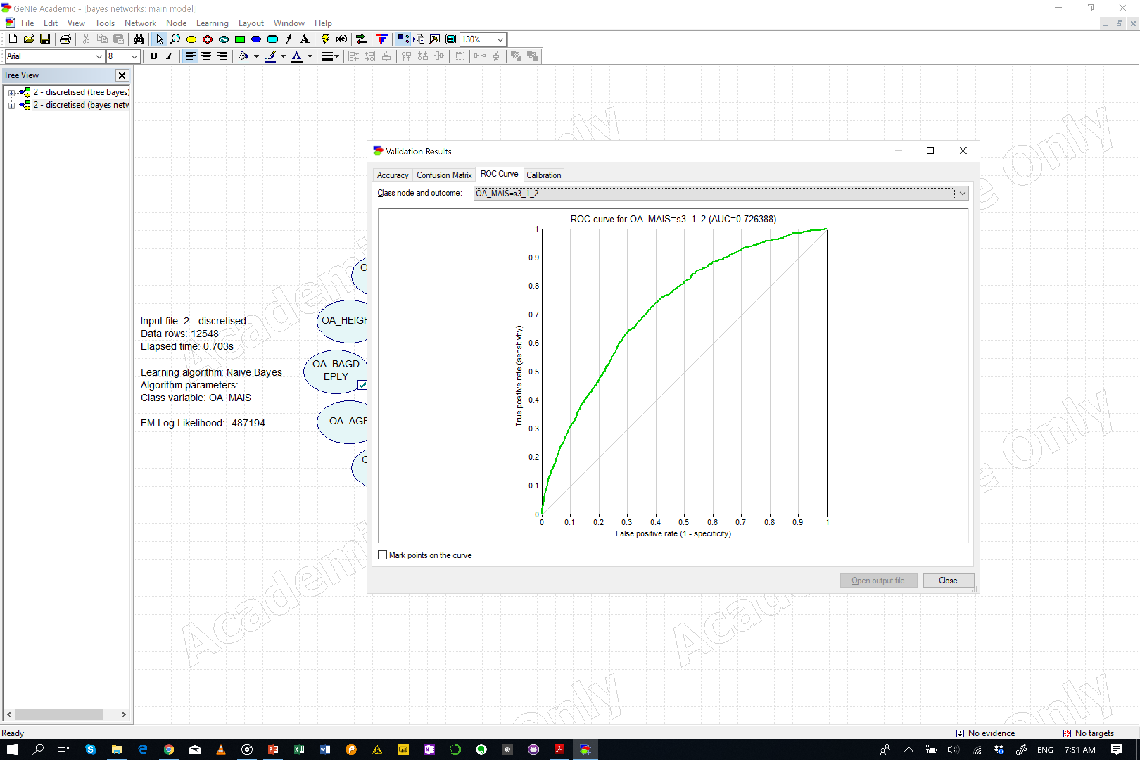
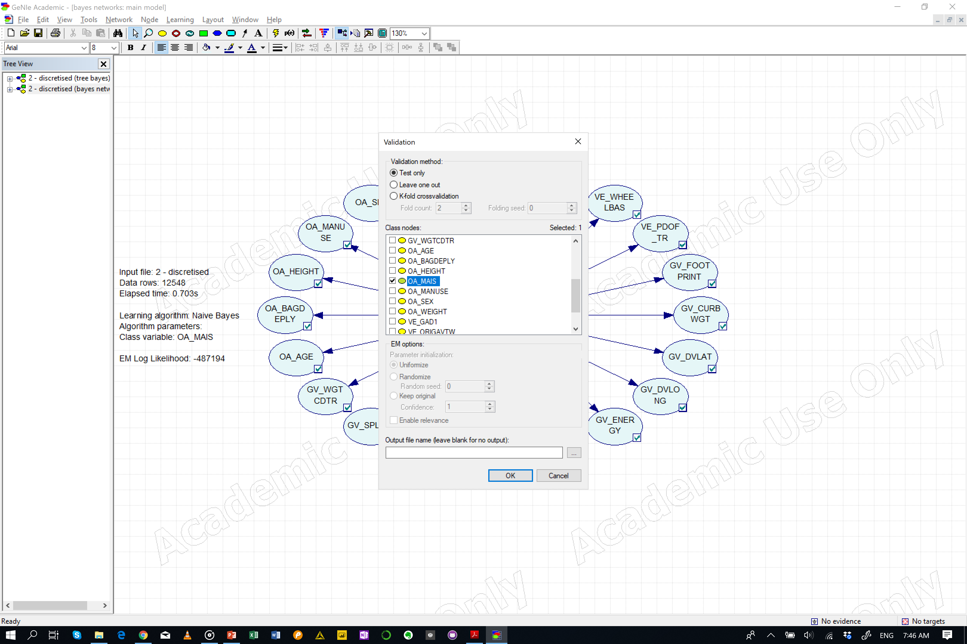
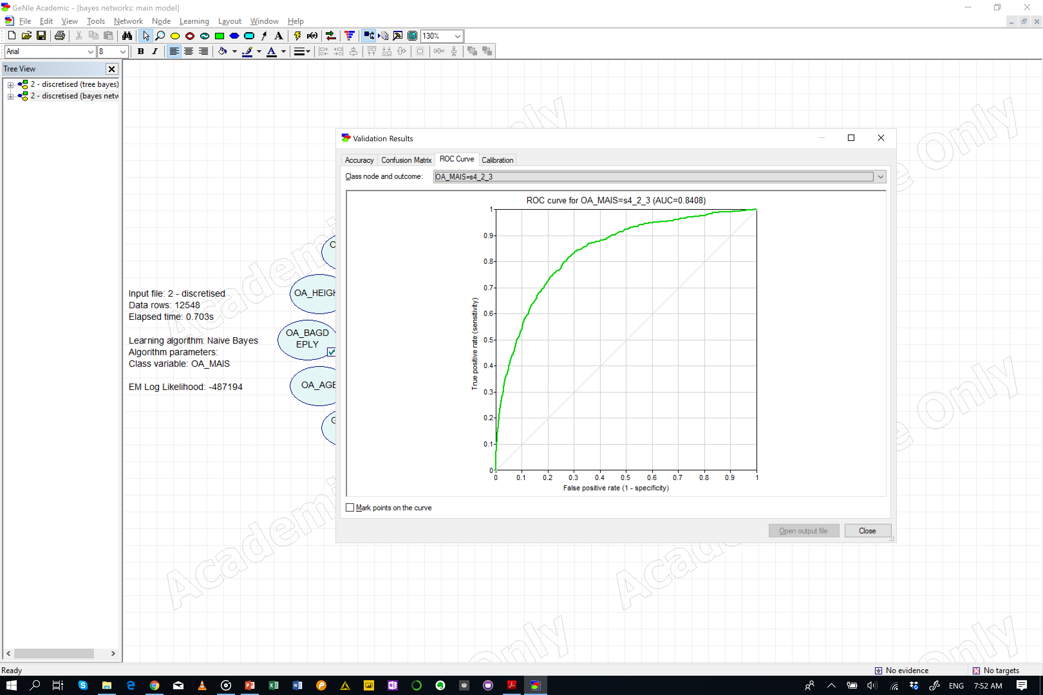
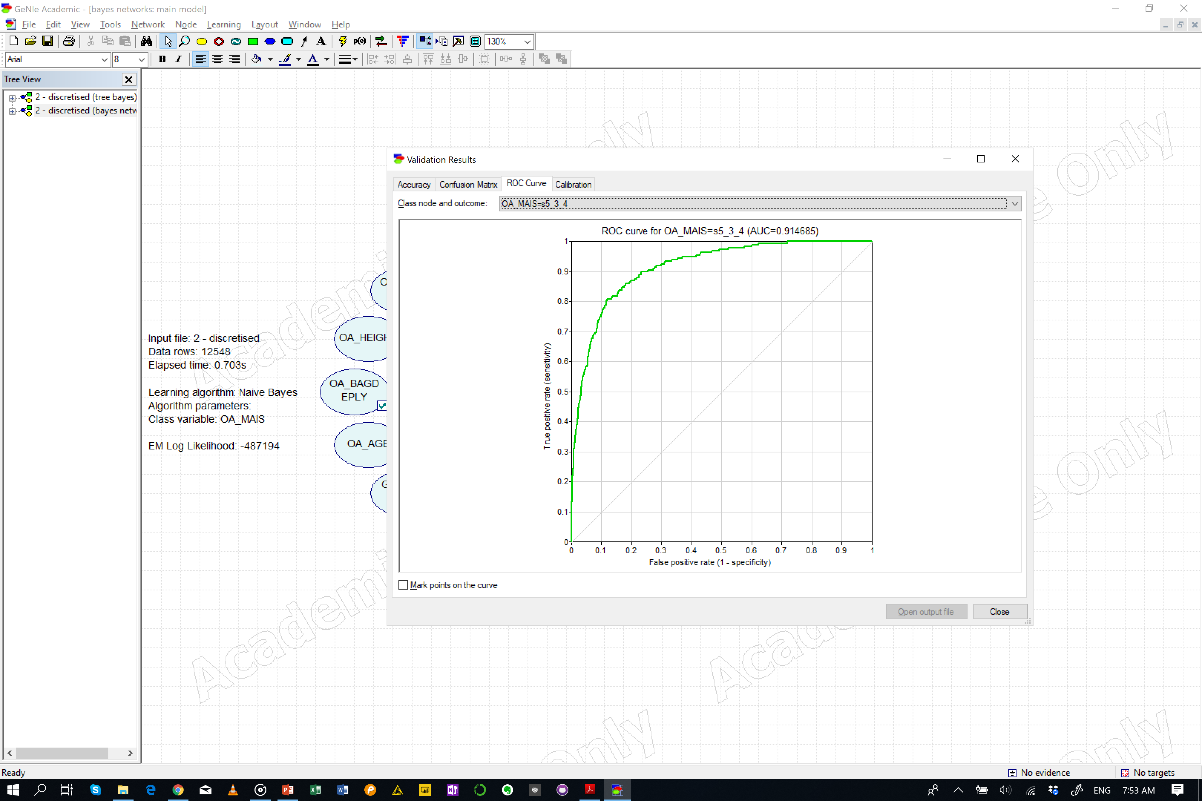
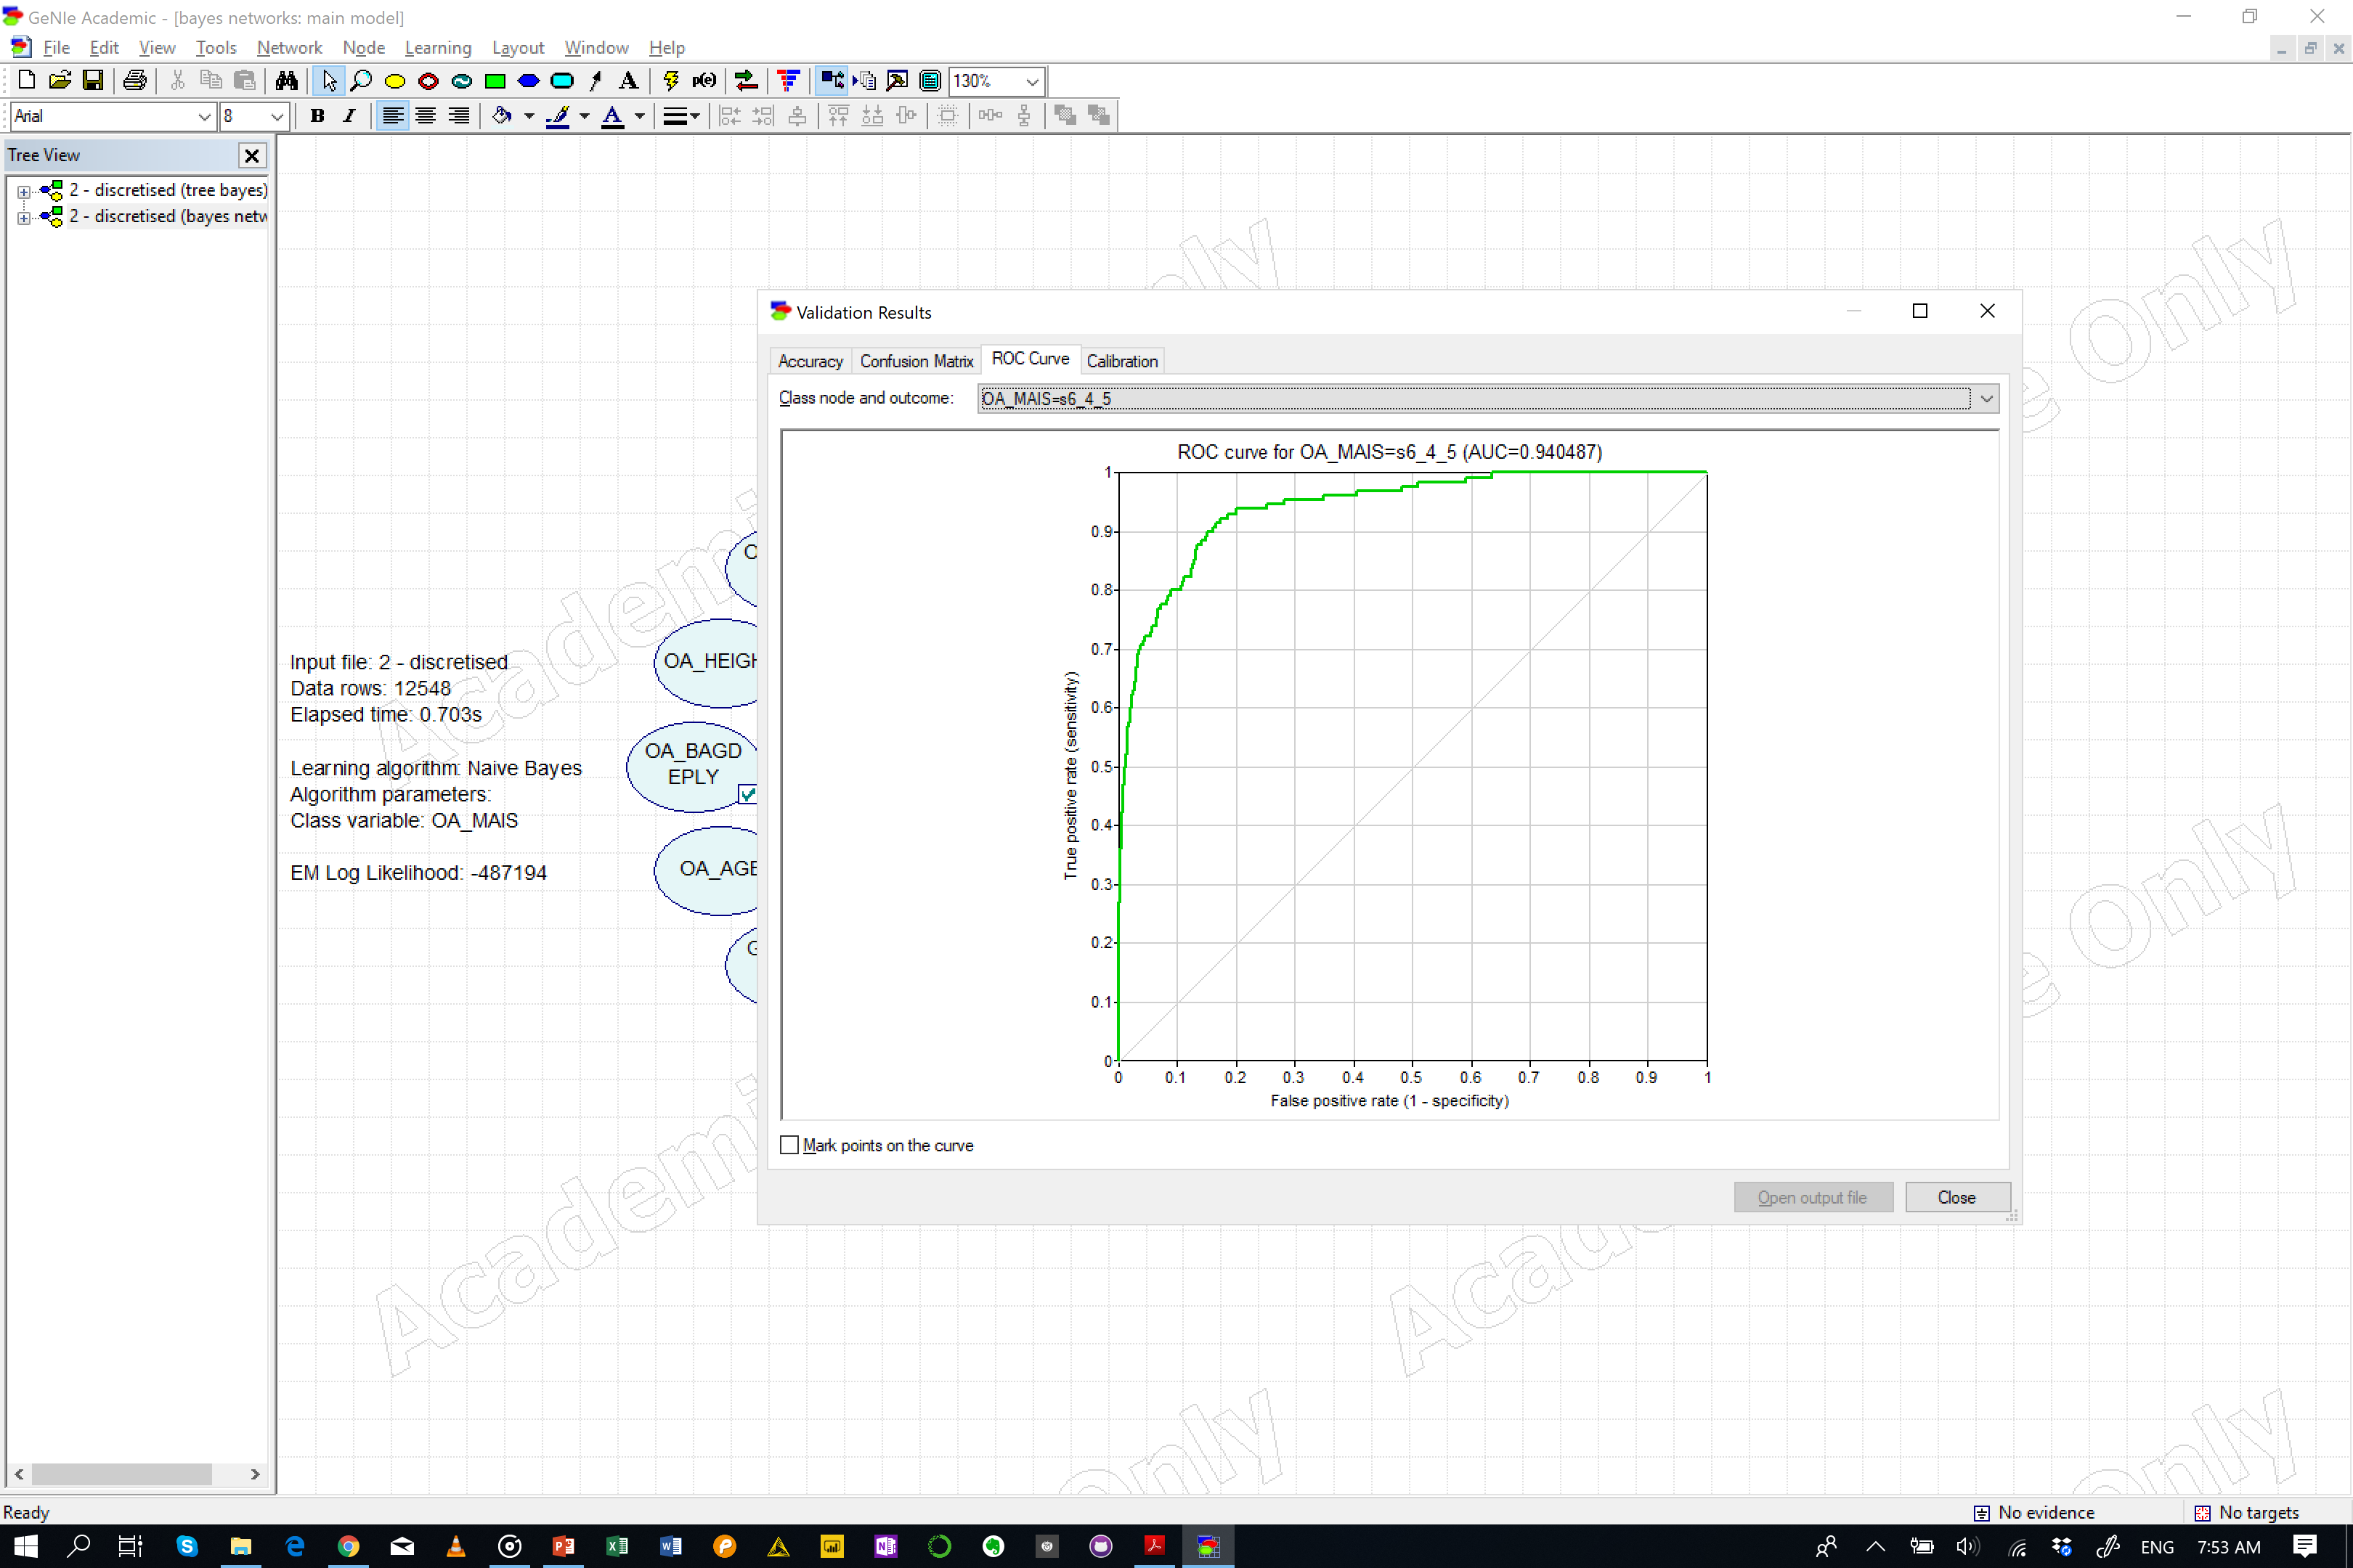
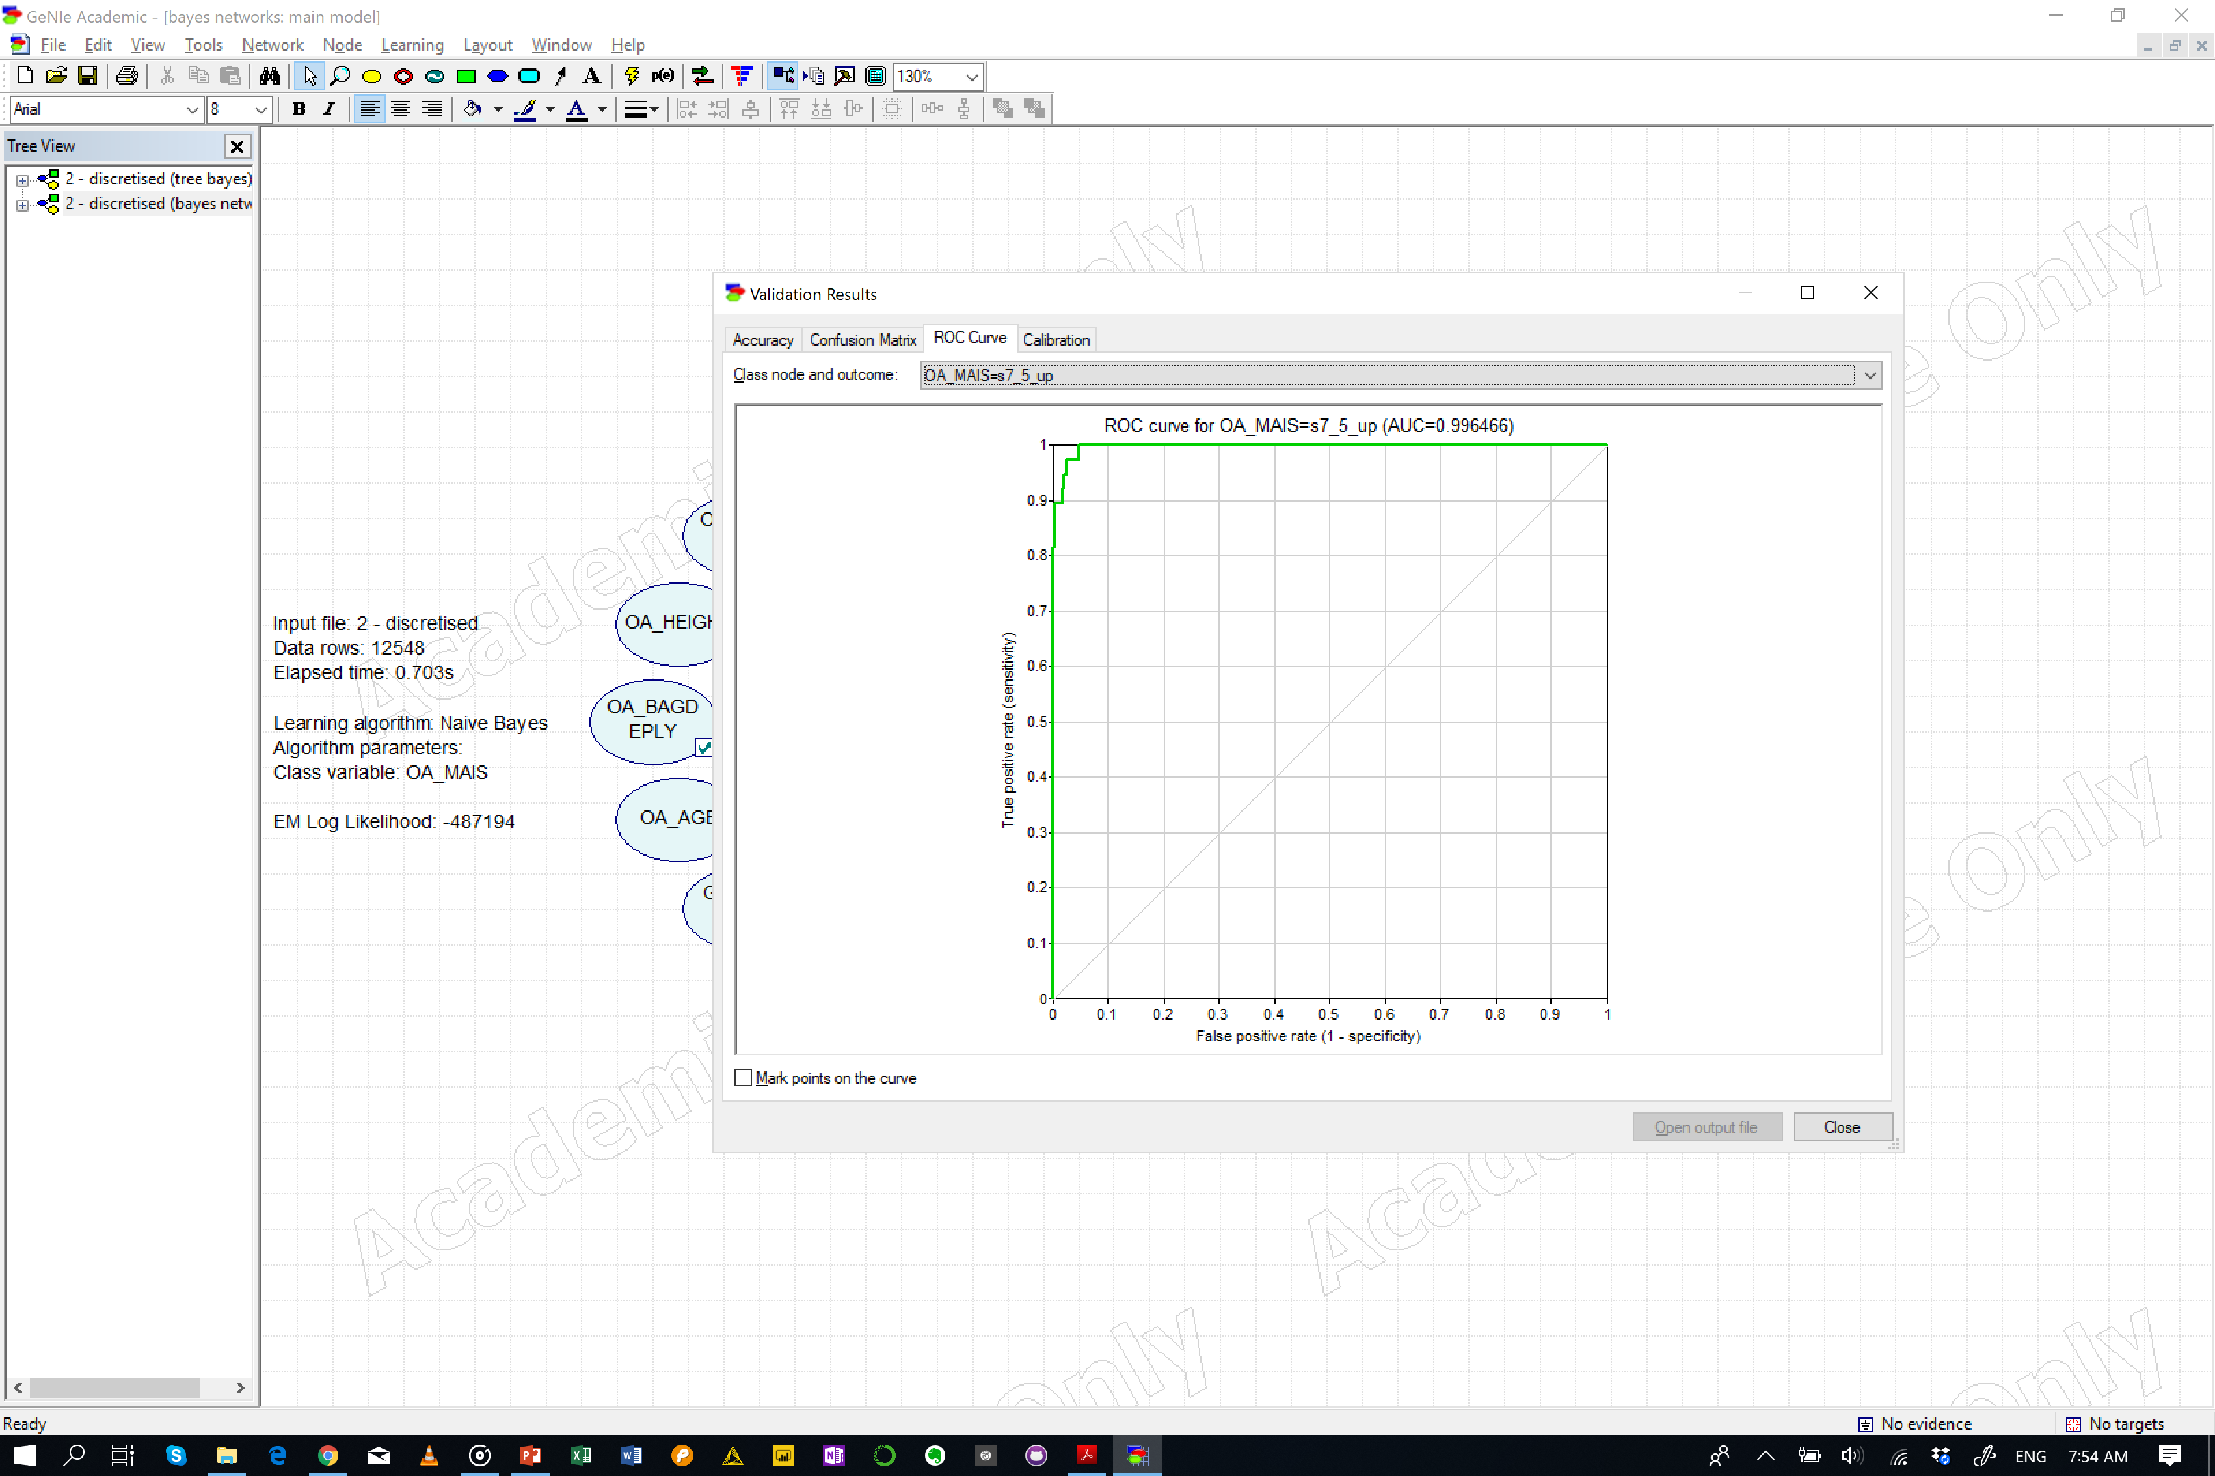
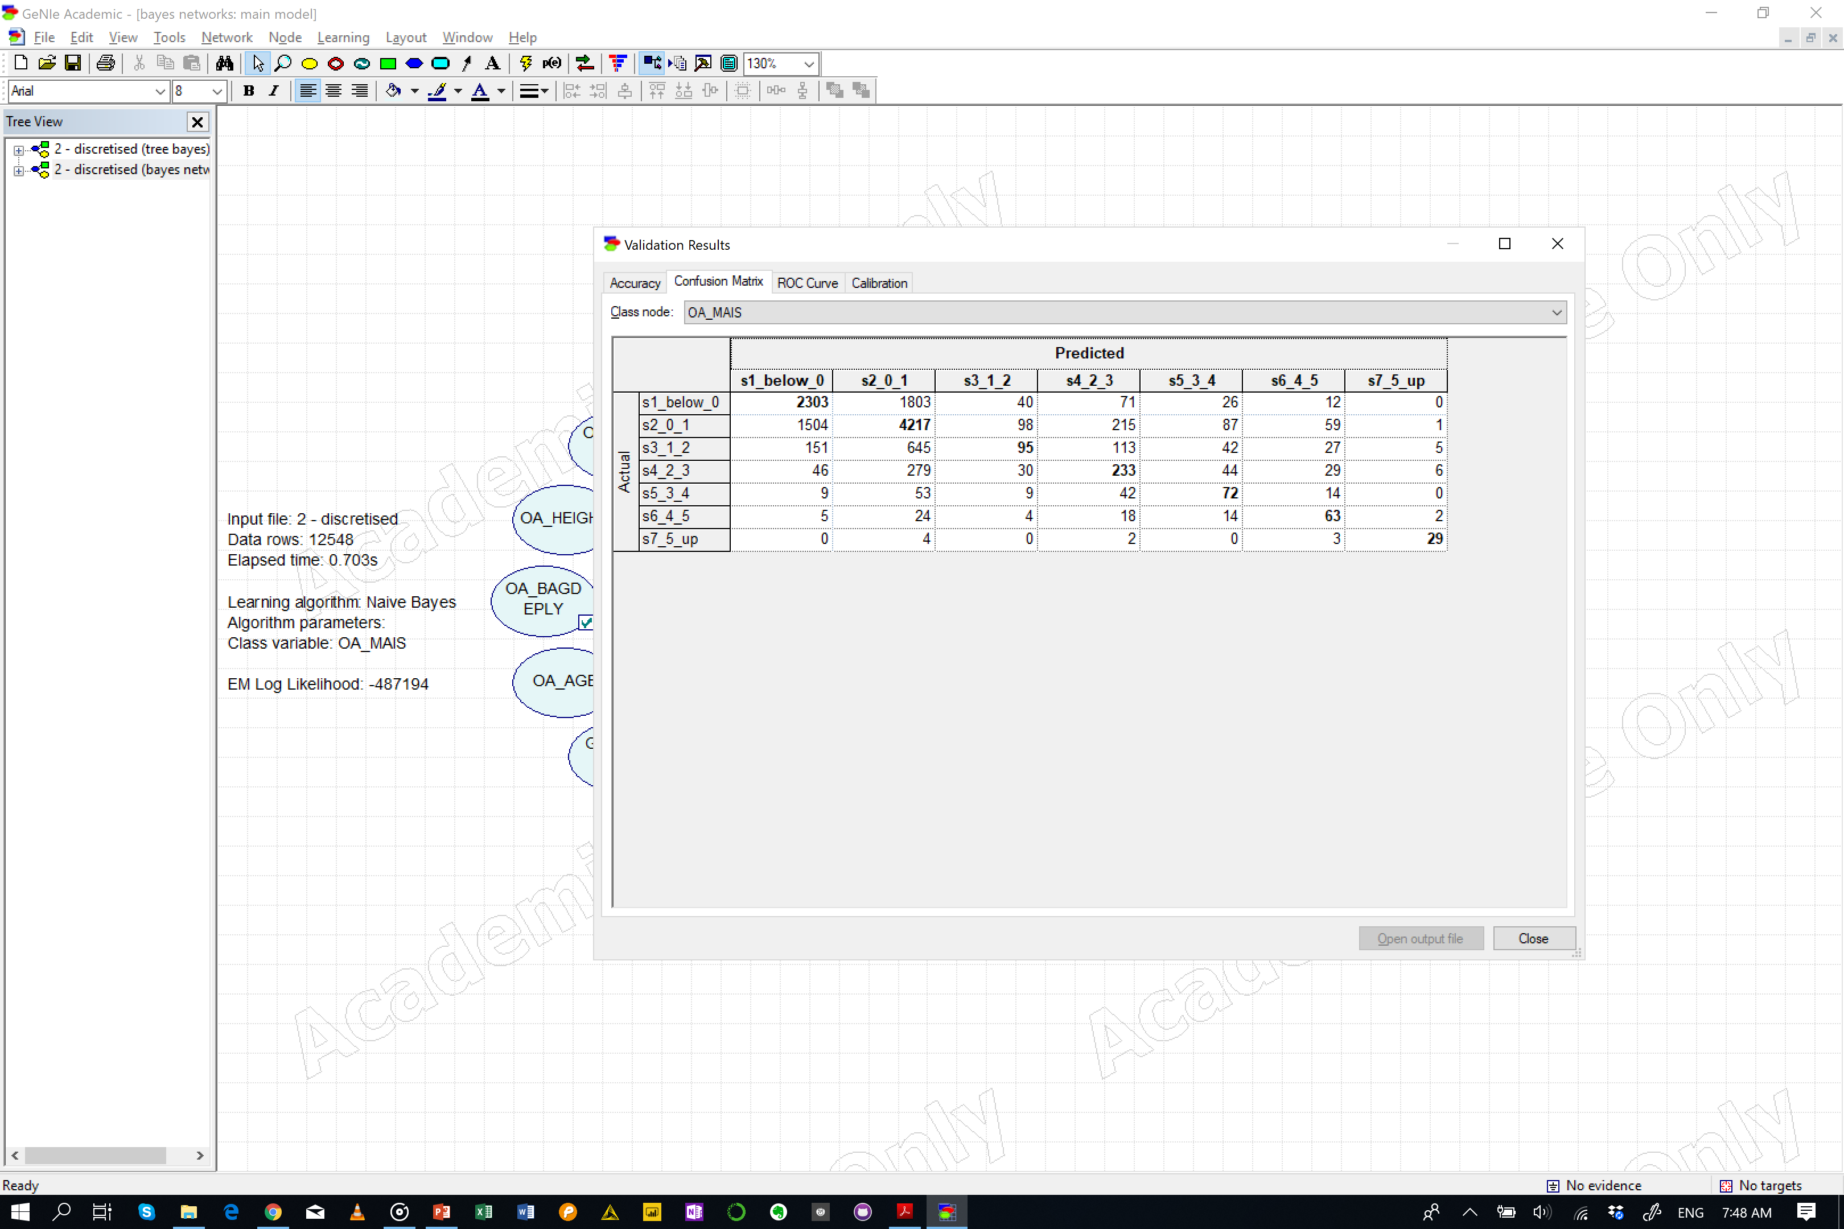
Test
Default
Naïve Bayes
Accuracy
OA_MAIS = 0.558814 (7012/12548)
s1_below_0 = 0.541246 (2303/4255)
s2_0_1 = 0.682252 (4217/6181)
s3_1_2 = 0.0881262 (95/1078)
s4_2_3 = 0.349325 (233/667)
s5_3_4 = 0.361809 (72/199)
s6_4_5 = 0.484615 (63/130)
s7_5_up = 0.763158 (29/38)

Slide 6
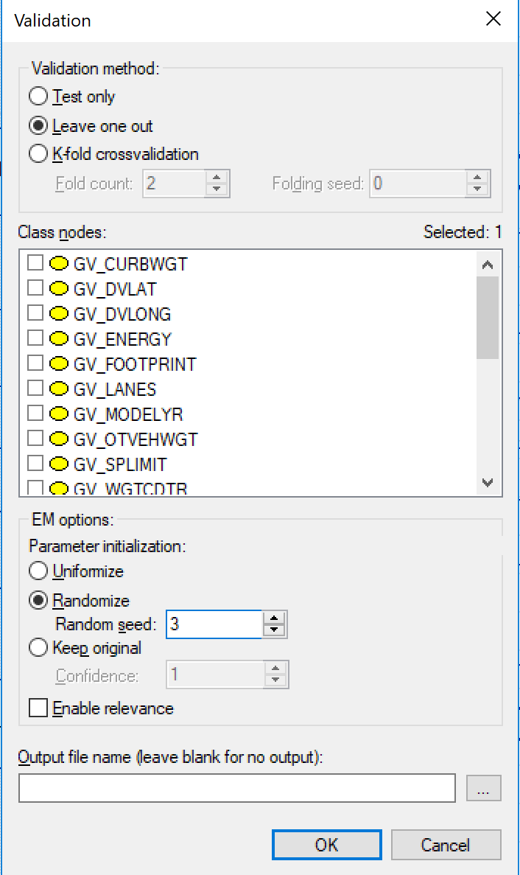
Test
Leave one out
Naïve Bayes
Accuracy
OA_MAIS = 0.558814 (7012/12548)
s1_below_0 = 0.541246 (2303/4255)
s2_0_1 = 0.682252 (4217/6181)
s3_1_2 = 0.0881262 (95/1078)
s4_2_3 = 0.349325 (233/667)
s5_3_4 = 0.361809 (72/199)
s6_4_5 = 0.484615 (63/130)
s7_5_up = 0.763158 (29/38)

Slide 7
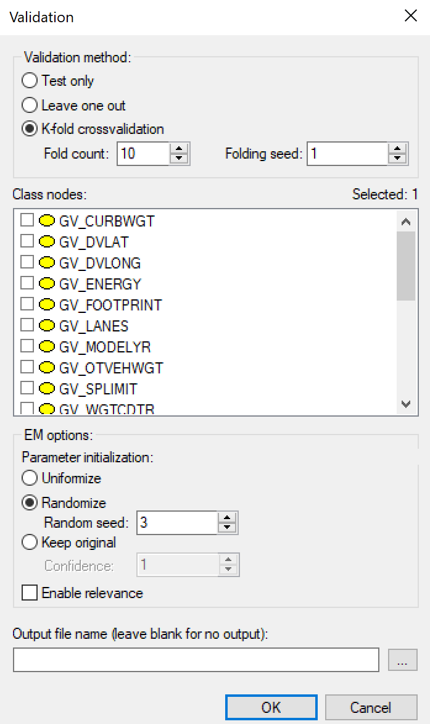
Test
K-fold (10)
Naïve Bayes
Accuracy
OA_MAIS = 0.527255 (6616/12548)
s1_below_0 = 0.516569 (2198/4255)
s2_0_1 = 0.667206 (4124/6181)
s3_1_2 = 0.0445269 (48/1078)
s4_2_3 = 0.266867 (178/667)
s5_3_4 = 0.201005 (40/199)
s6_4_5 = 0.192308 (25/130)
s7_5_up = 0.0789474 (3/38)
 |  | Predicted
 |  | s1_below_0 | s2_0_1 | s3_1_2 | s4_2_3 | s5_3_4 | s6_4_5 | s7_5_up
Actual | s1_below_0 | 2198 | 1900 | 48 | 71 | 28 | 10 | 0
 | s2_0_1 | 1562 | 4124 | 118 | 216 | 102 | 58 | 1
 | s3_1_2 | 147 | 667 | 48 | 130 | 45 | 33 | 8
 | s4_2_3 | 50 | 306 | 46 | 178 | 57 | 26 | 4
 | s5_3_4 | 11 | 58 | 14 | 51 | 40 | 25 | 0
 | s6_4_5 | 5 | 31 | 5 | 30 | 29 | 25 | 5
 | s7_5_up | 0 | 4 | 7 | 11 | 2 | 11 | 3

Slide 8
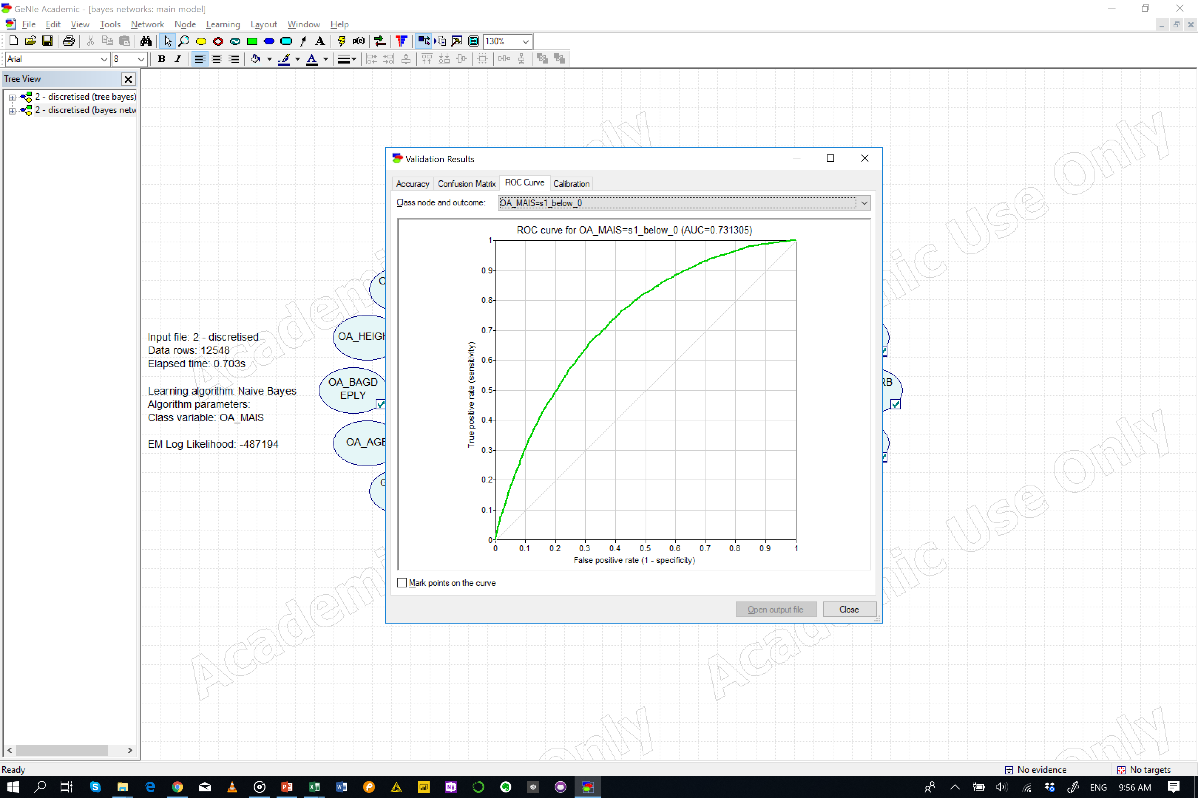

Test
K-fold (20)
Naïve Bayes
Accuracy
OA_MAIS = 0.527654 (6621/12548)
s1_below_0 = 0.519154 (2209/4255)
s2_0_1 = 0.667206 (4124/6181)
s3_1_2 = 0.0482375 (52/1078)
s4_2_3 = 0.254873 (170/667)
s5_3_4 = 0.190955 (38/199)
s6_4_5 = 0.192308 (25/130)
s7_5_up = 0.0789474 (3/38)
 |  | Predicted
 |  | s1_below_0 | s2_0_1 | s3_1_2 | s4_2_3 | s5_3_4 | s6_4_5 | s7_5_up
Actual | s1_below_0 | 2209 | 1888 | 44 | 79 | 25 | 10 | 0
 | s2_0_1 | 1571 | 4124 | 120 | 206 | 99 | 59 | 2
 | s3_1_2 | 151 | 663 | 52 | 130 | 43 | 33 | 6
 | s4_2_3 | 51 | 307 | 51 | 170 | 56 | 29 | 3
 | s5_3_4 | 12 | 58 | 12 | 52 | 38 | 26 | 1
 | s6_4_5 | 5 | 28 | 7 | 30 | 29 | 25 | 6
 | s7_5_up | 0 | 4 | 5 | 15 | 2 | 9 | 3

Slide 9
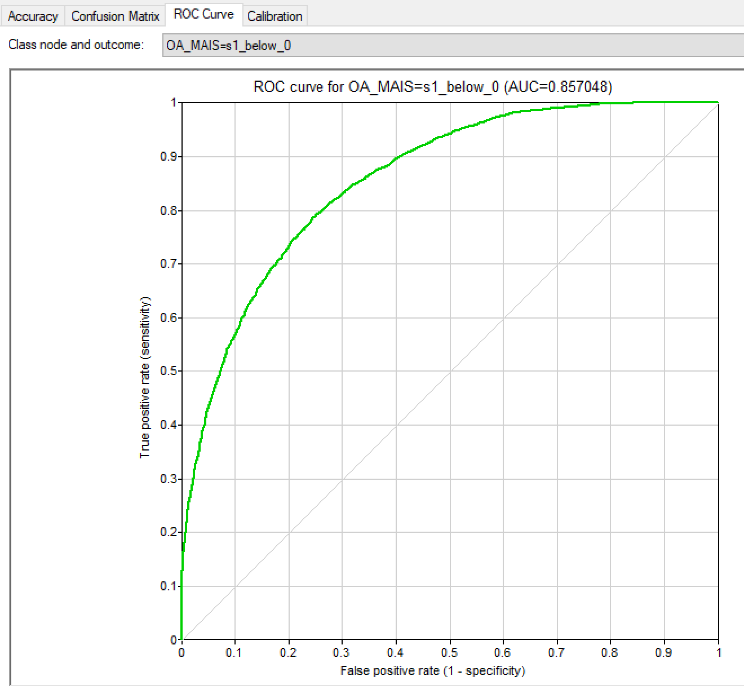
Test
Default
Tree Augmented Bayes
Accuracy
OA_MAIS = 0.702263 (8812/12548)
s1_below_0 = 0.66416 (2826/4255)
s2_0_1 = 0.777221 (4804/6181)
s3_1_2 = 0.416512 (449/1078)
s4_2_3 = 0.628186 (419/667)
s5_3_4 = 0.844221 (168/199)
s6_4_5 = 0.838462 (109/130)
s7_5_up = 0.973684 (37/38)
 |  | Predicted
 |  | s1_below_0 | s2_0_1 | s3_1_2 | s4_2_3 | s5_3_4 | s6_4_5 | s7_5_up
Actual | s1_below_0 | 2826 | 1295 | 71 | 53 | 6 | 4 | 0
 | s2_0_1 | 1077 | 4804 | 155 | 114 | 19 | 11 | 1
 | s3_1_2 | 116 | 460 | 449 | 40 | 9 | 3 | 1
 | s4_2_3 | 42 | 175 | 21 | 419 | 9 | 1 | 0
 | s5_3_4 | 6 | 17 | 1 | 5 | 168 | 2 | 0
 | s6_4_5 | 4 | 11 | 1 | 5 | 0 | 109 | 0
 | s7_5_up | 0 | 1 | 0 | 0 | 0 | 0 | 37

Slide 10
Test
Leave One Out
Tree Augmented Bayes
Accuracy
OA_MAIS = 0.702263 (8812/12548)
s1_below_0 = 0.66416 (2826/4255)
s2_0_1 = 0.777221 (4804/6181)
s3_1_2 = 0.416512 (449/1078)
s4_2_3 = 0.628186 (419/667)
s5_3_4 = 0.844221 (168/199)
s6_4_5 = 0.838462 (109/130)
s7_5_up = 0.973684 (37/38)
 |  | Predicted
 |  | s1_below_0 | s2_0_1 | s3_1_2 | s4_2_3 | s5_3_4 | s6_4_5 | s7_5_up
Actual | s1_below_0 | 2826 | 1295 | 71 | 53 | 6 | 4 | 0
 | s2_0_1 | 1077 | 4804 | 155 | 114 | 19 | 11 | 1
 | s3_1_2 | 116 | 460 | 449 | 40 | 9 | 3 | 1
 | s4_2_3 | 42 | 175 | 21 | 419 | 9 | 1 | 0
 | s5_3_4 | 6 | 17 | 1 | 5 | 168 | 2 | 0
 | s6_4_5 | 4 | 11 | 1 | 5 | 0 | 109 | 0
 | s7_5_up | 0 | 1 | 0 | 0 | 0 | 0 | 37

Slide 11
Test
K-fold (10)
Tree Augmented Bayes
Accuracy
OA_MAIS = 0.535544 (6720/12548)
s1_below_0 = 0.502938 (2140/4255)
s2_0_1 = 0.660896 (4085/6181)
s3_1_2 = 0.151206 (163/1078)
s4_2_3 = 0.277361 (185/667)
s5_3_4 = 0.316583 (63/199)
s6_4_5 = 0.407692 (53/130)
s7_5_up = 0.815789 (31/38)
 |  | Predicted
 |  | s1_below_0 | s2_0_1 | s3_1_2 | s4_2_3 | s5_3_4 | s6_4_5 | s7_5_up
Actual | s1_below_0 | 2140 | 1924 | 109 | 69 | 7 | 5 | 1
 | s2_0_1 | 1596 | 4085 | 267 | 182 | 34 | 14 | 3
 | s3_1_2 | 166 | 635 | 163 | 87 | 16 | 9 | 2
 | s4_2_3 | 63 | 314 | 82 | 185 | 17 | 6 | 0
 | s5_3_4 | 16 | 61 | 23 | 33 | 63 | 3 | 0
 | s6_4_5 | 6 | 37 | 8 | 19 | 7 | 53 | 0
 | s7_5_up | 0 | 1 | 5 | 1 | 0 | 0 | 31

Slide 12
Test
K-fold (20)
Tree Augmented Bayes
Accuracy
OA_MAIS = 0.535464 (6719/12548)
s1_below_0 = 0.502703 (2139/4255)
s2_0_1 = 0.662676 (4096/6181)
s3_1_2 = 0.14564 (157/1078)
s4_2_3 = 0.274363 (183/667)
s5_3_4 = 0.301508 (60/199)
s6_4_5 = 0.415385 (54/130)
s7_5_up = 0.789474 (30/38)
 |  | Predicted
 |  | s1_below_0 | s2_0_1 | s3_1_2 | s4_2_3 | s5_3_4 | s6_4_5 | s7_5_up
Actual | s1_below_0 | 2139 | 1919 | 109 | 73 | 8 | 6 | 1
 | s2_0_1 | 1583 | 4096 | 270 | 186 | 29 | 14 | 3
 | s3_1_2 | 165 | 644 | 157 | 84 | 18 | 9 | 1
 | s4_2_3 | 63 | 317 | 84 | 183 | 15 | 5 | 0
 | s5_3_4 | 17 | 62 | 23 | 32 | 60 | 5 | 0
 | s6_4_5 | 7 | 32 | 12 | 19 | 6 | 54 | 0
 | s7_5_up | 0 | 1 | 5 | 1 | 0 | 1 | 30

